Slide 1
EV Transition Figures
Automatically generated from reports/figures

Slide 2
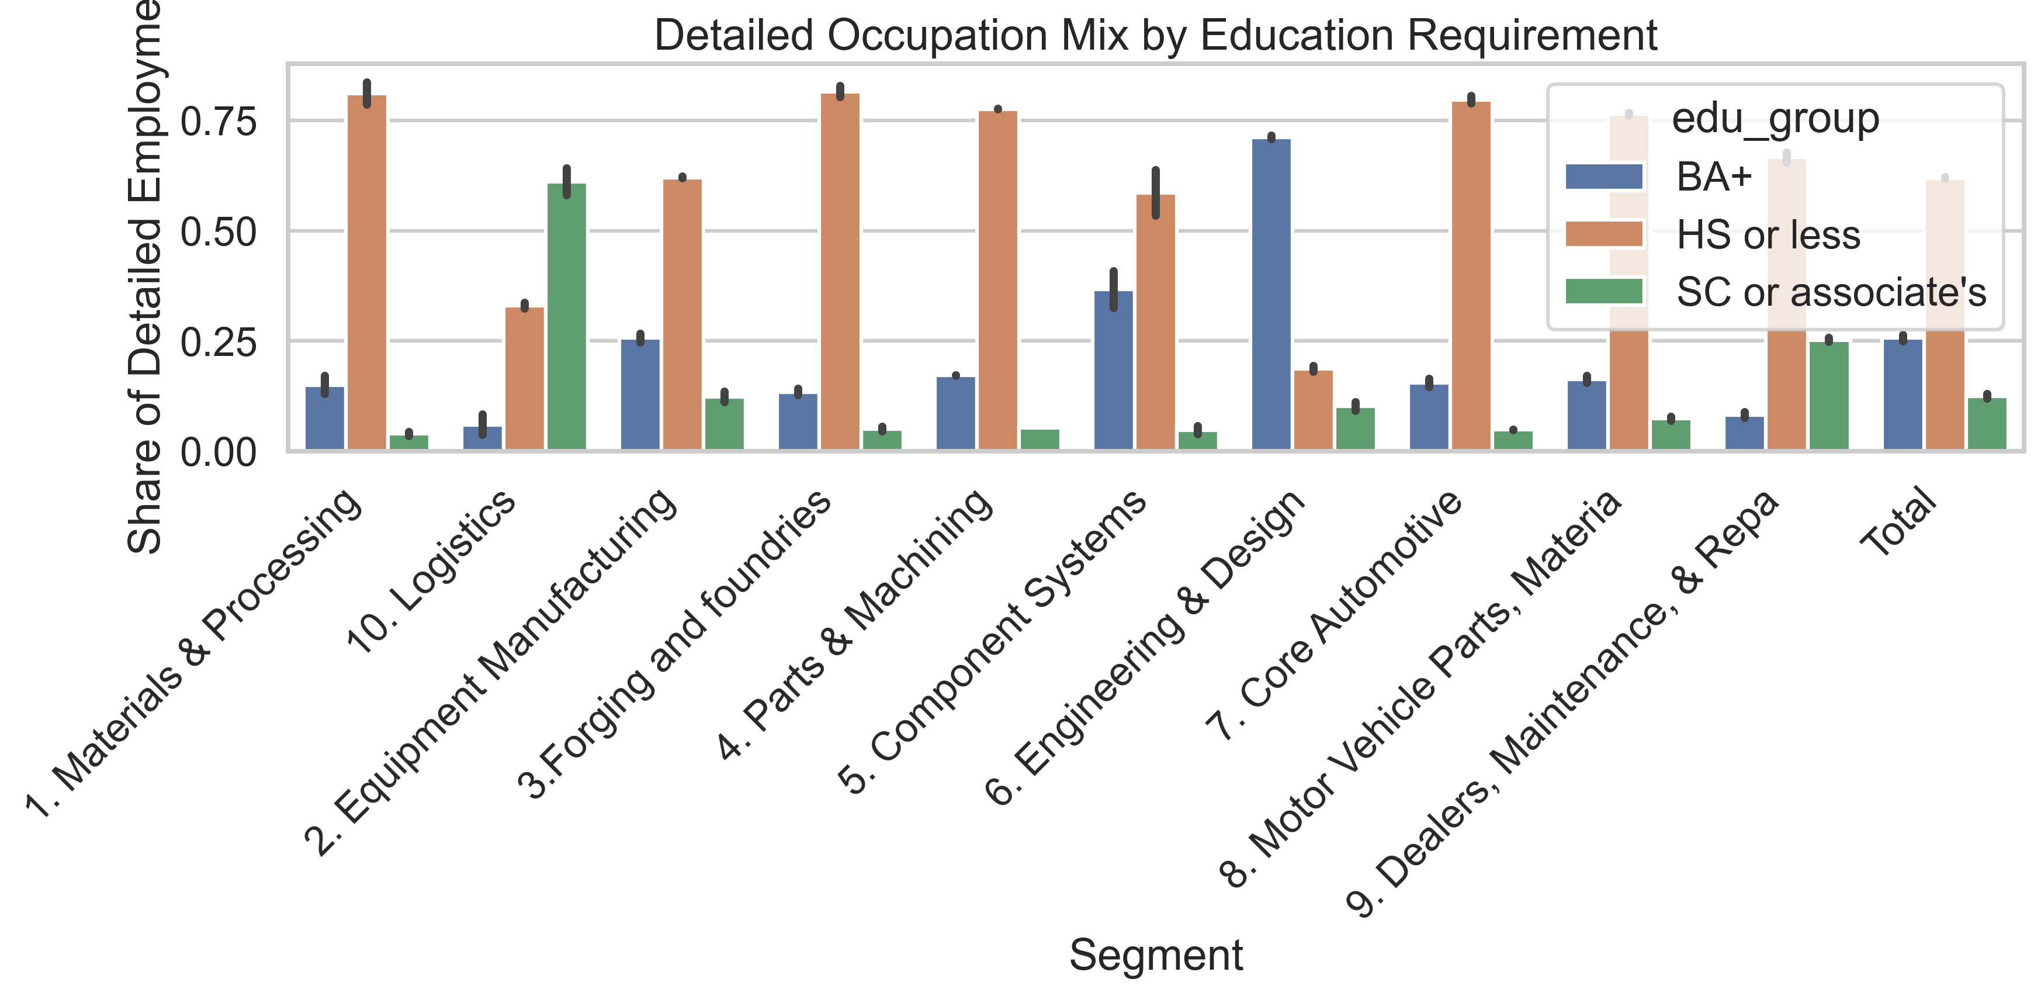
Mcda Detailed Education Mix
Source: EV Transition Forecasts

Slide 3
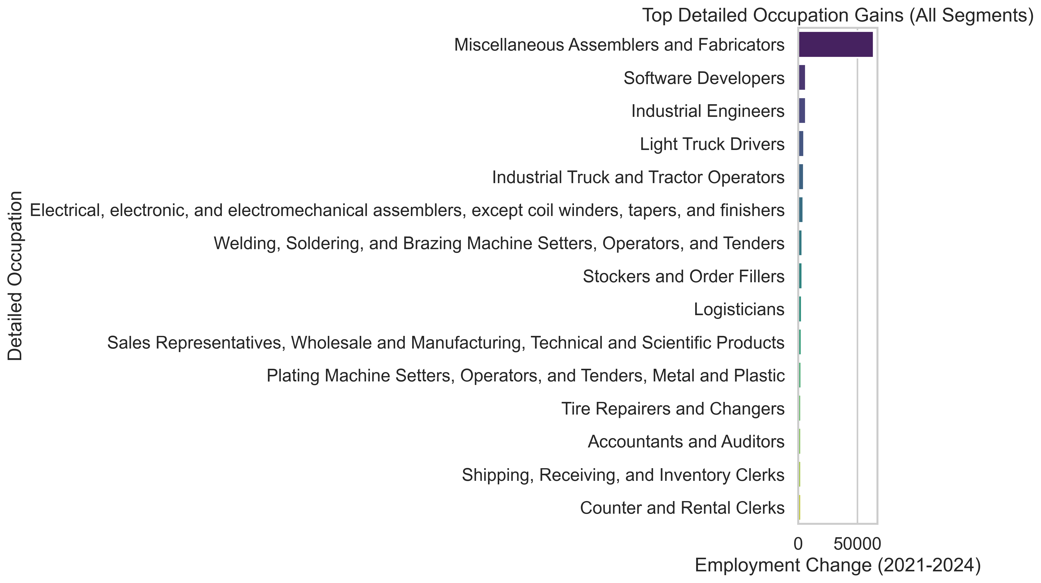
Mcda Detailed Top Changes
Source: EV Transition Forecasts

Slide 4
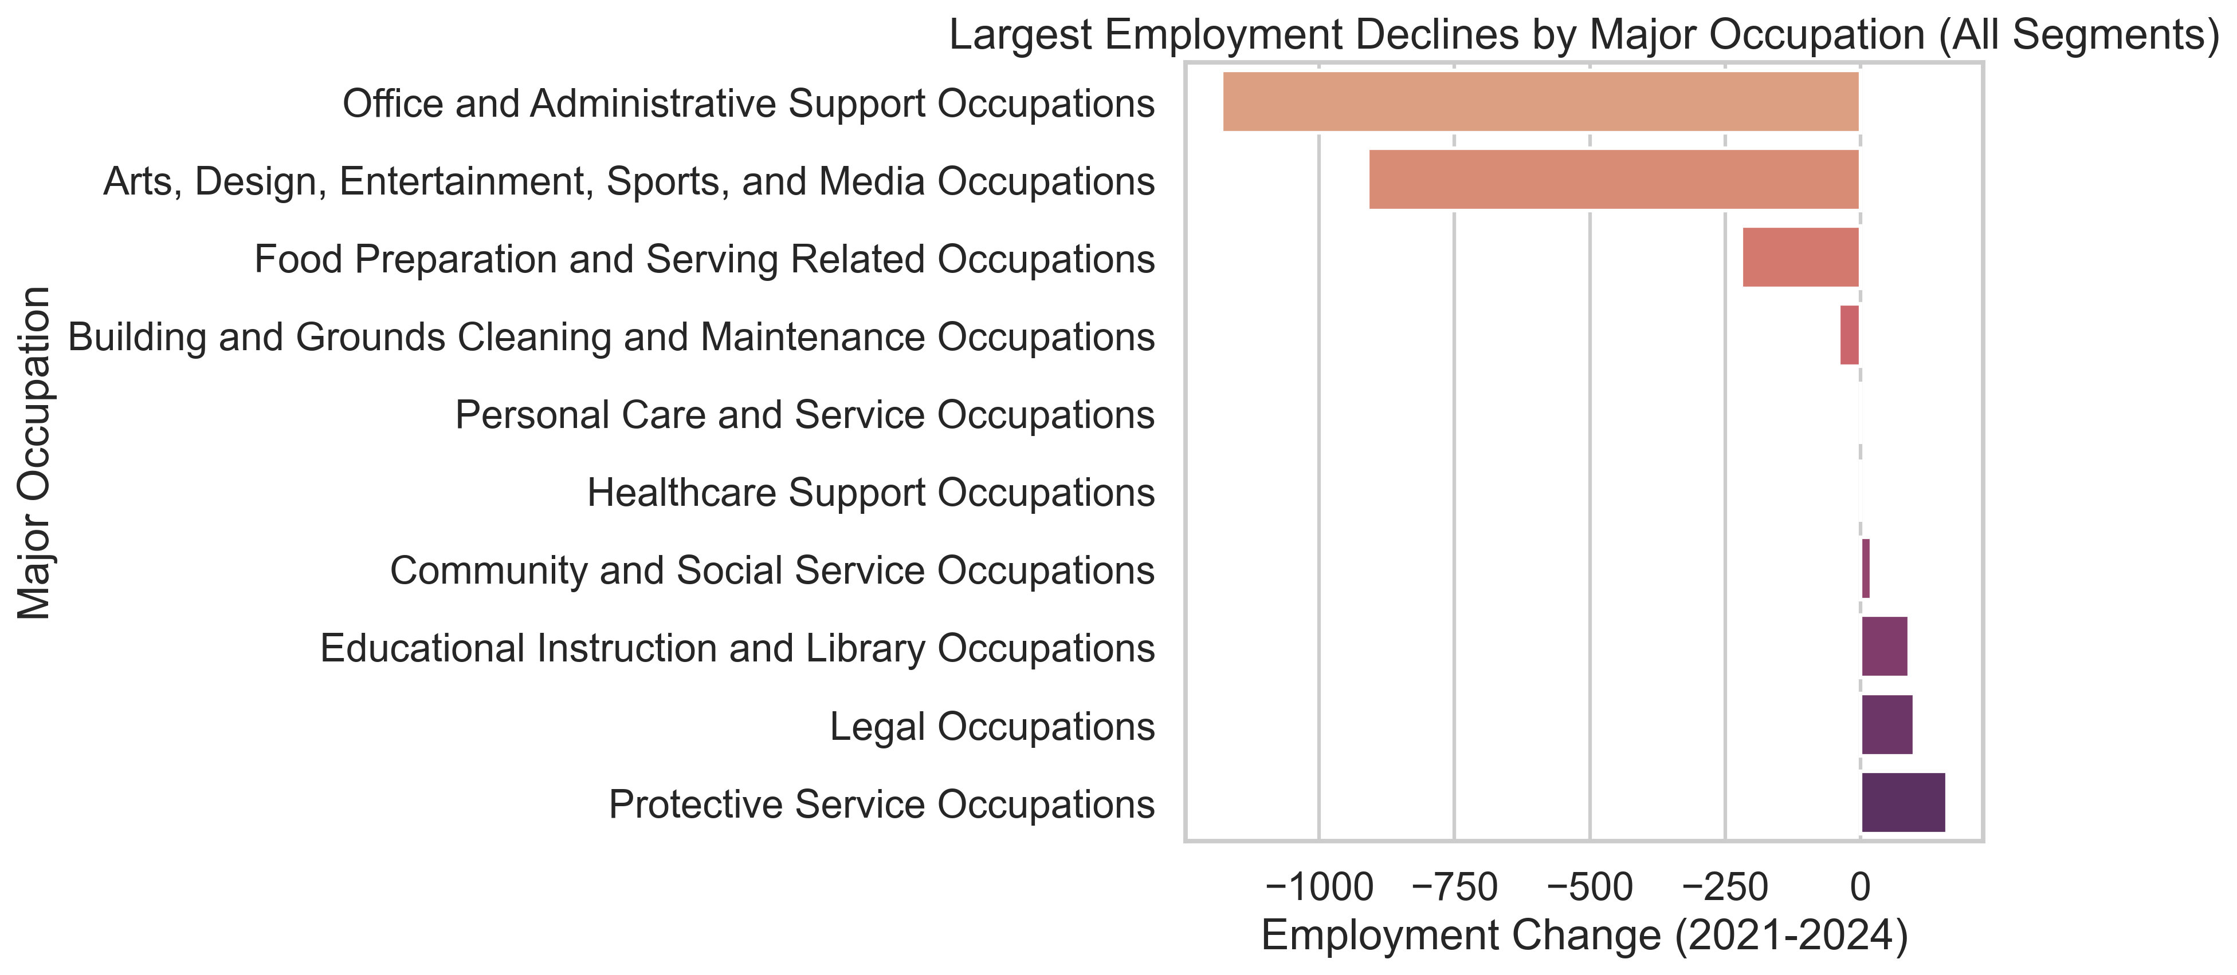
Mcda Major Bottom Changes
Source: EV Transition Forecasts

Slide 5
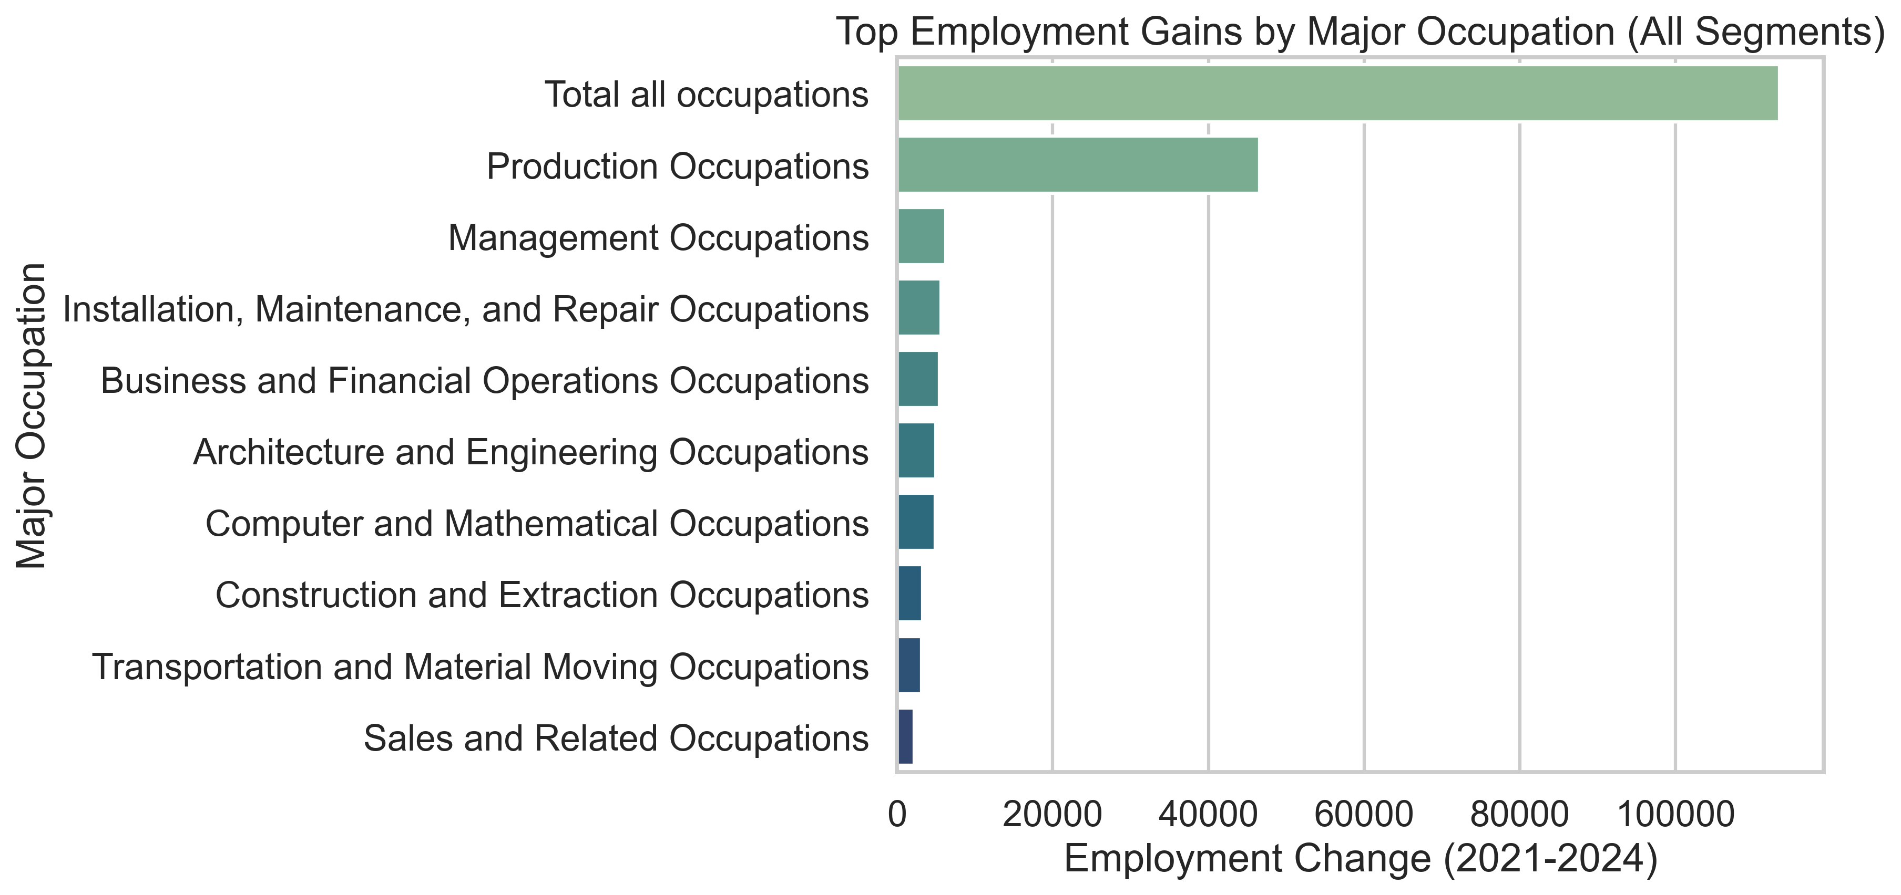
Mcda Major Top Changes
Source: EV Transition Forecasts

Slide 6
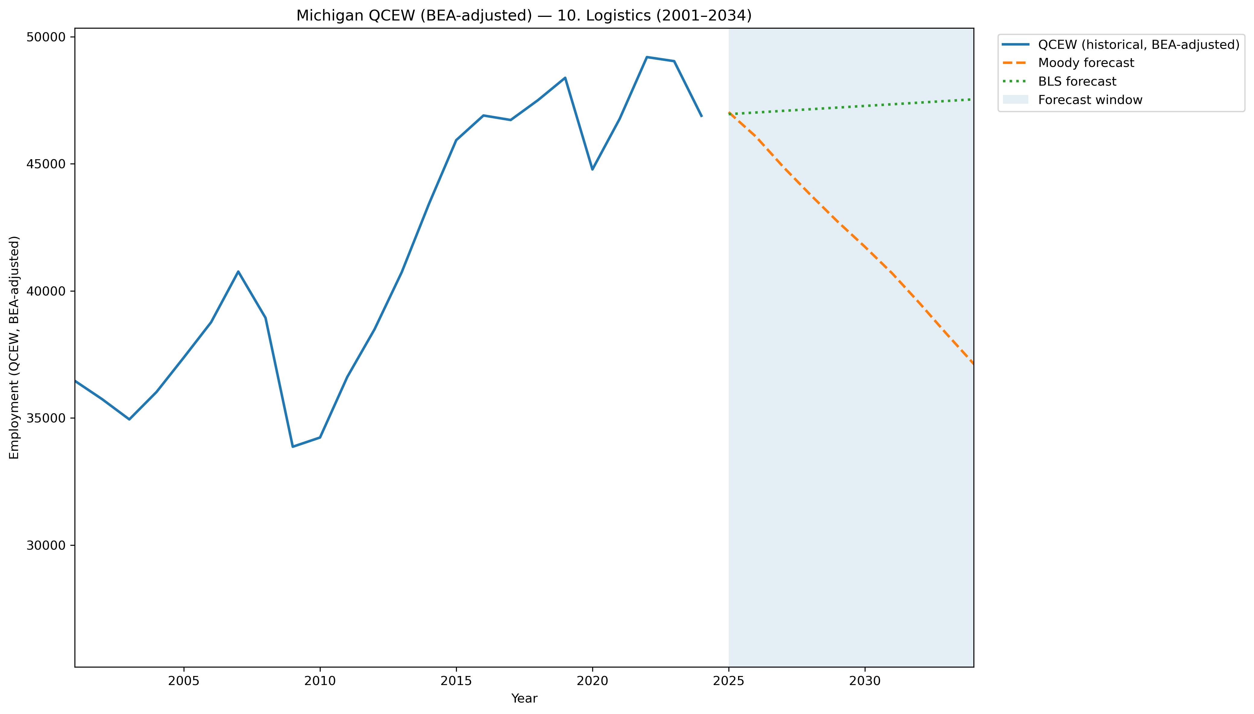
Mi Qcew Bea Segment 10 Compare 2001 2034
Source: EV Transition Forecasts

Slide 7
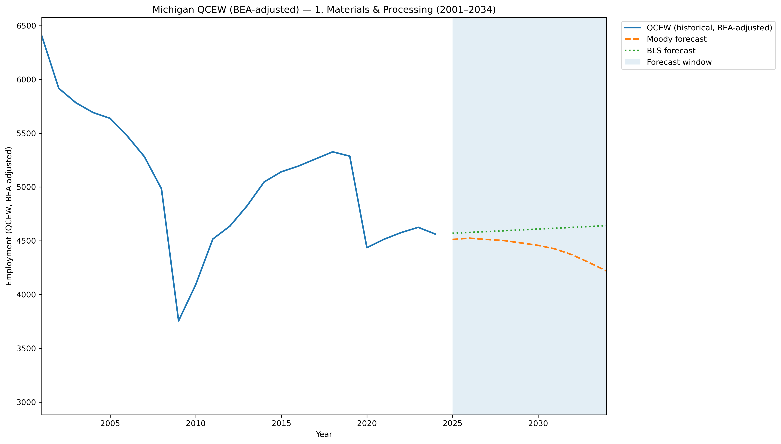
Mi Qcew Bea Segment 1 Compare 2001 2034
Source: EV Transition Forecasts

Slide 8
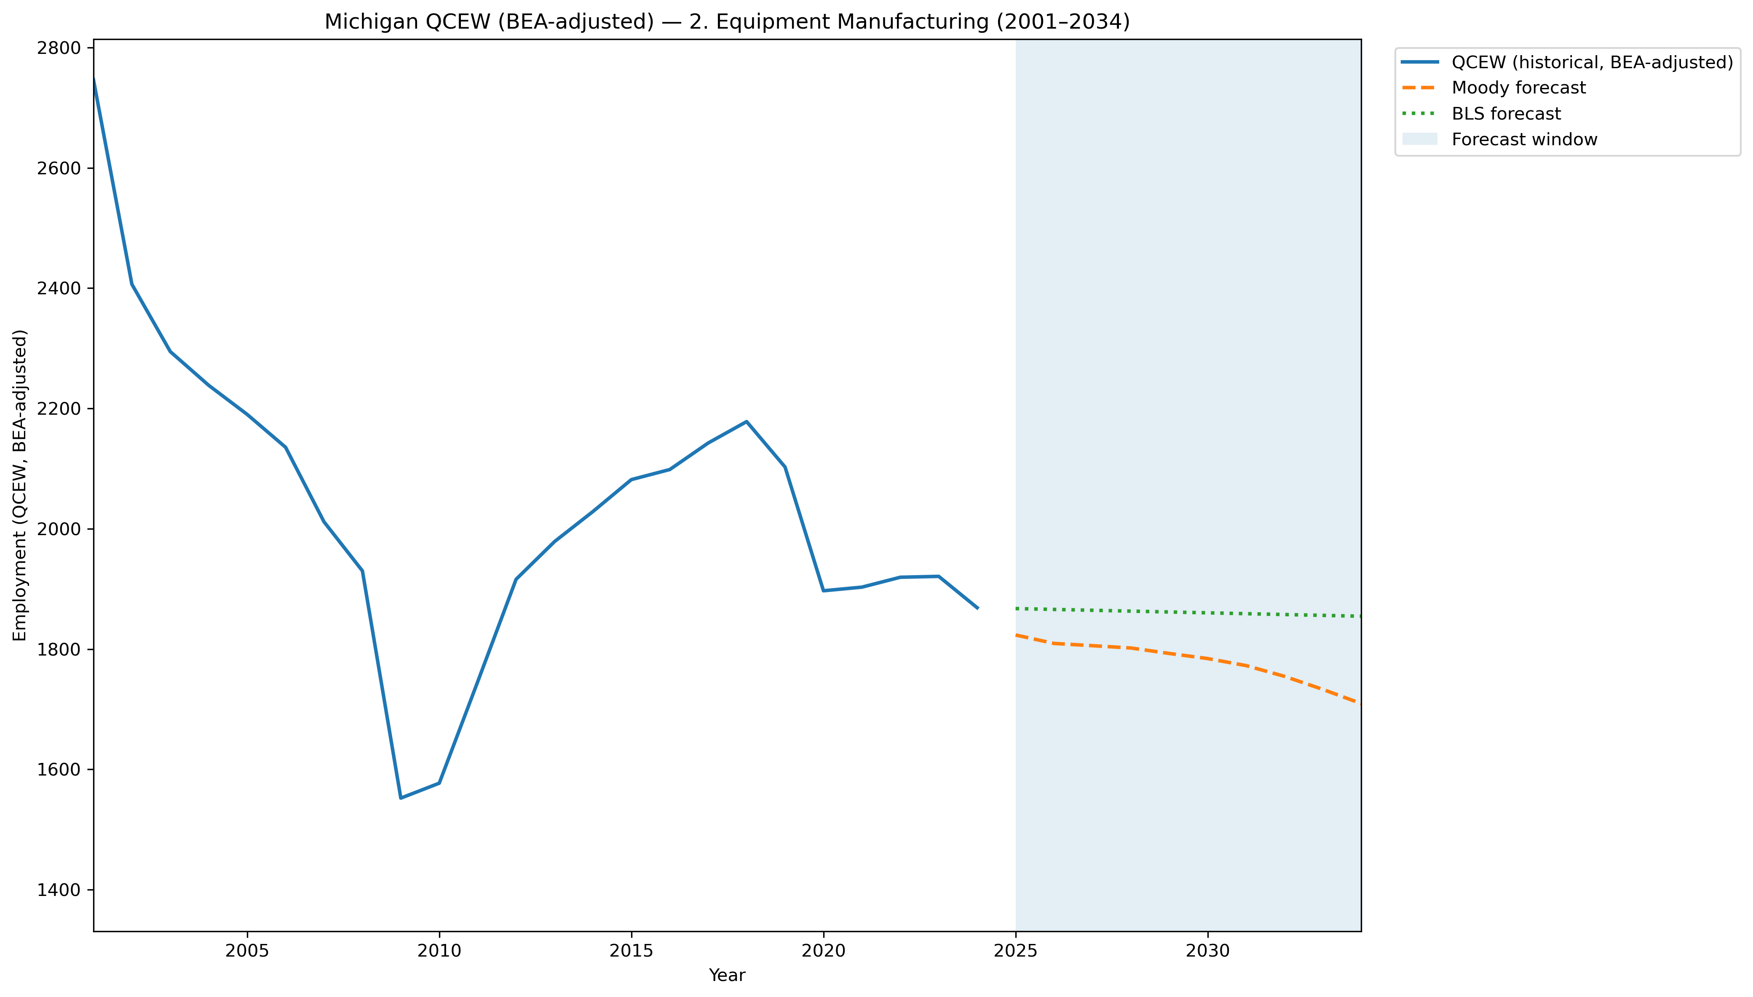
Mi Qcew Bea Segment 2 Compare 2001 2034
Source: EV Transition Forecasts

Slide 9
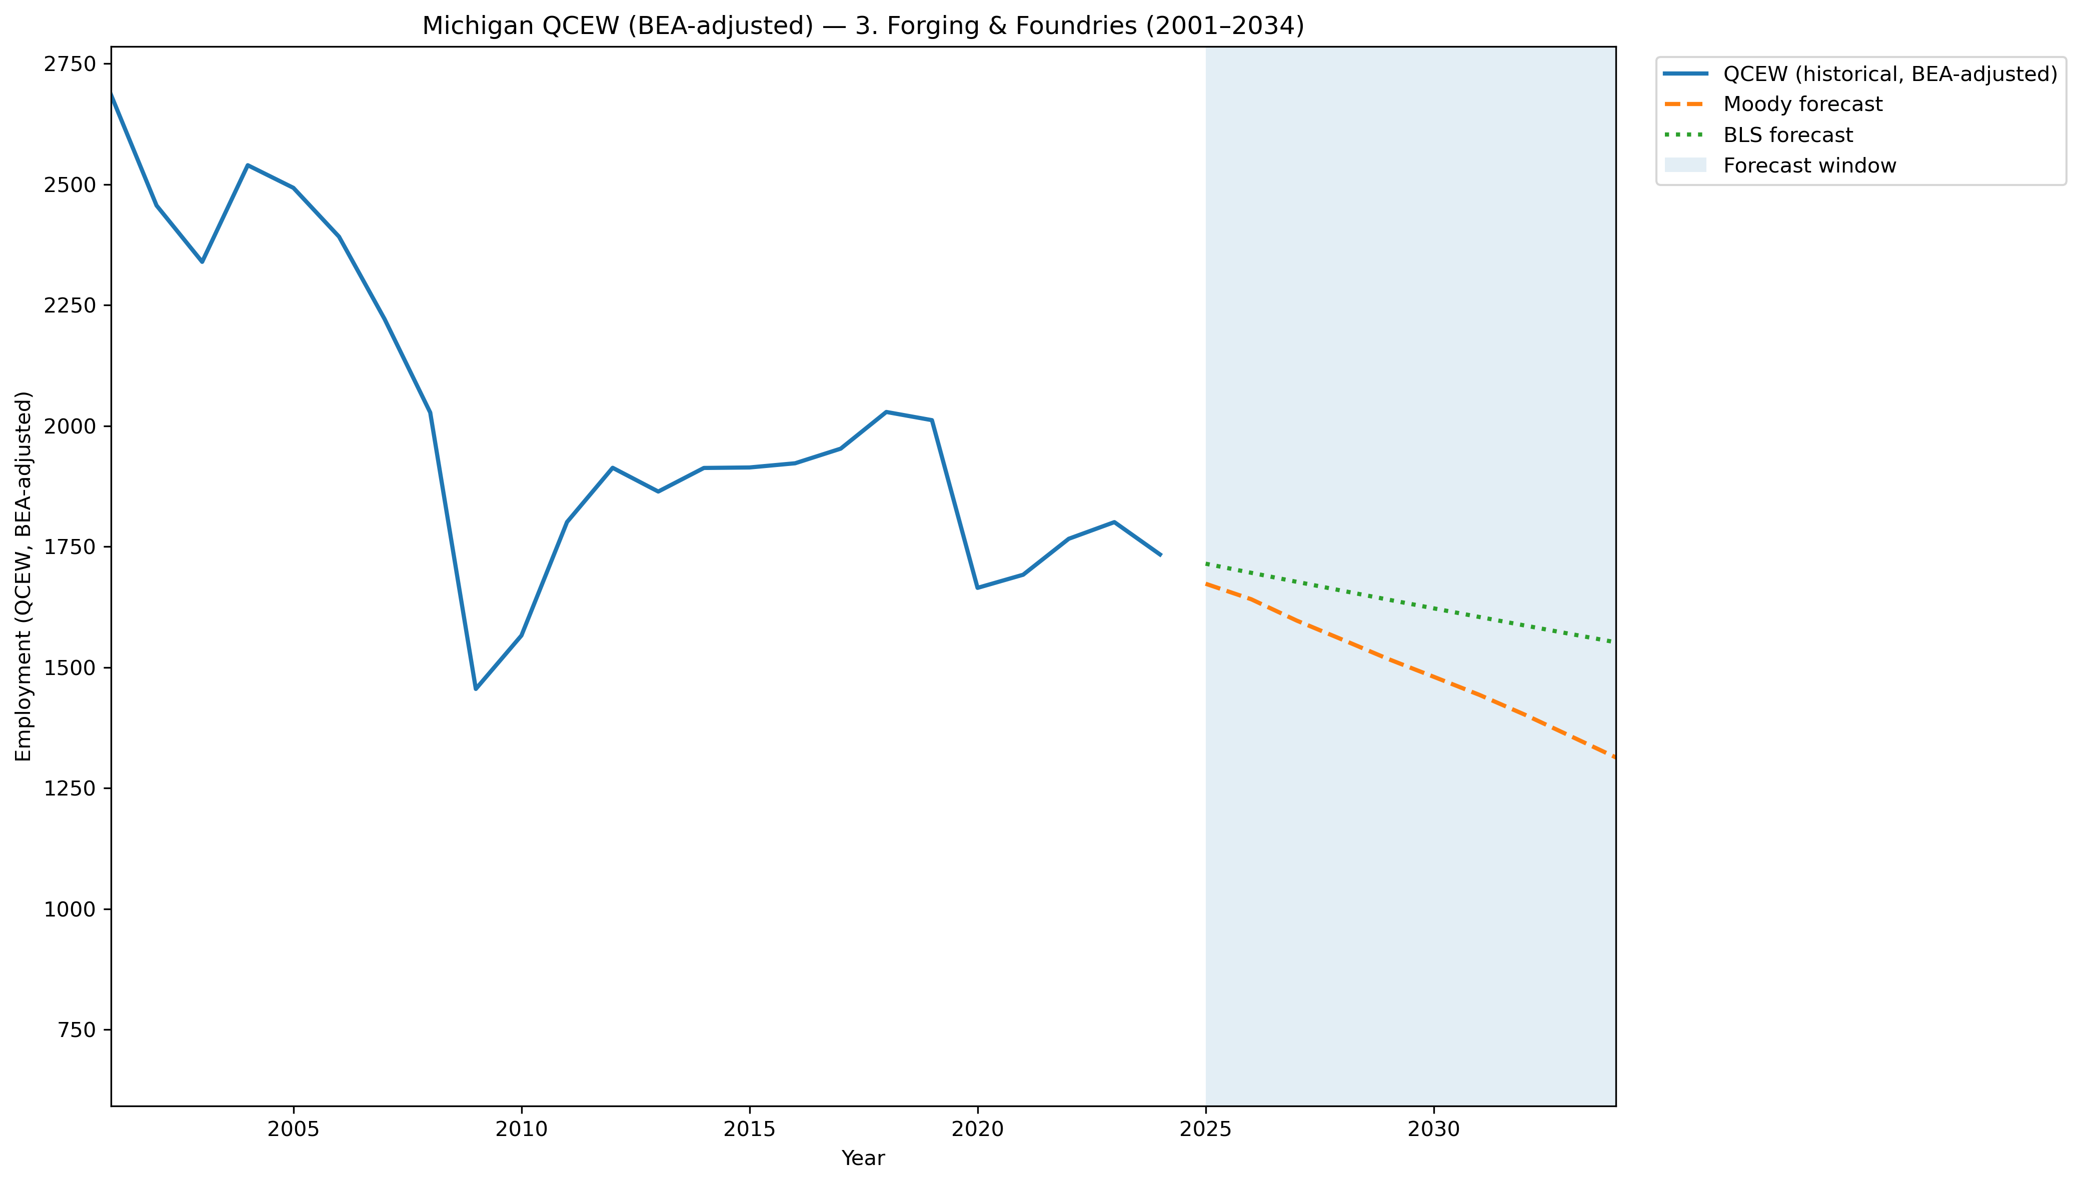
Mi Qcew Bea Segment 3 Compare 2001 2034
Source: EV Transition Forecasts

Slide 10
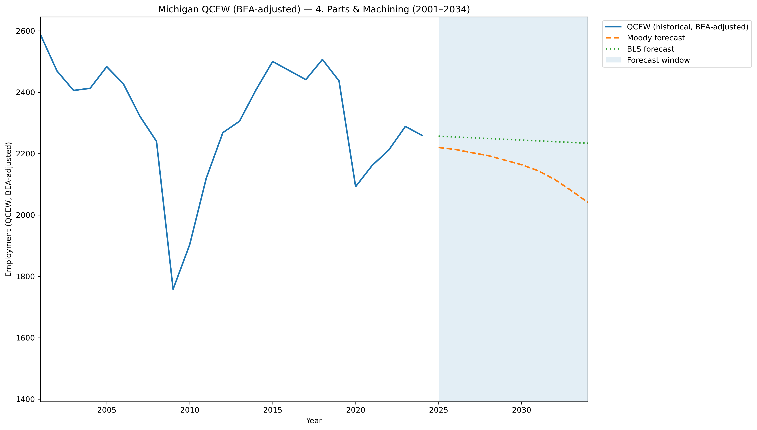
Mi Qcew Bea Segment 4 Compare 2001 2034
Source: EV Transition Forecasts

Slide 11
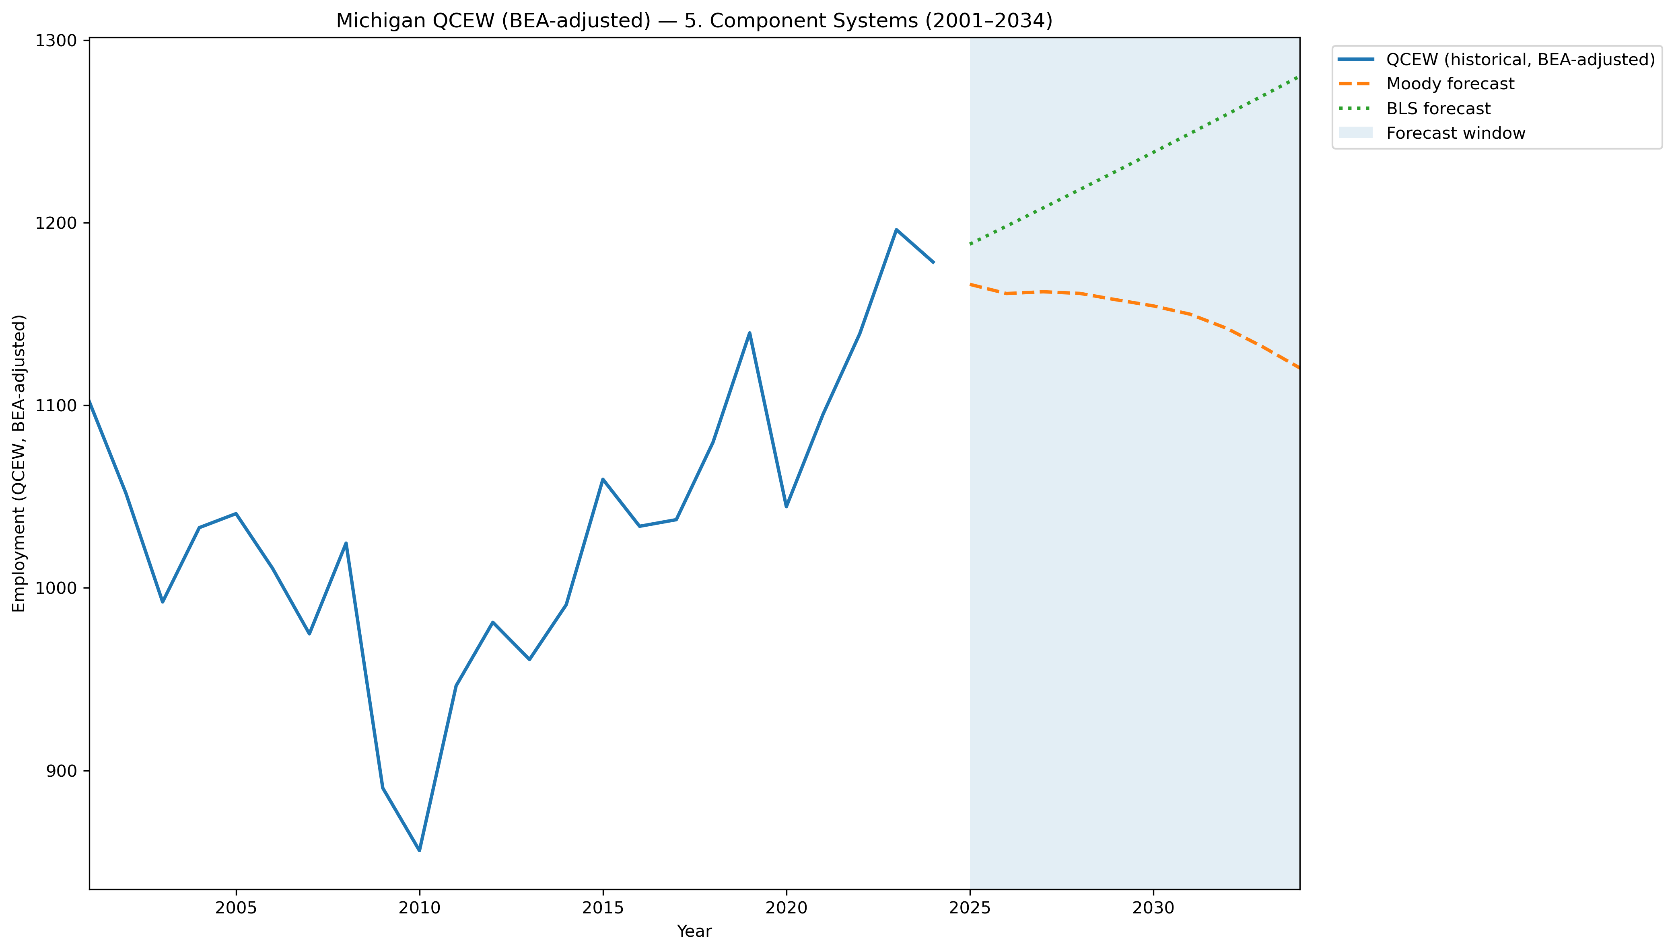
Mi Qcew Bea Segment 5 Compare 2001 2034
Source: EV Transition Forecasts

Slide 12
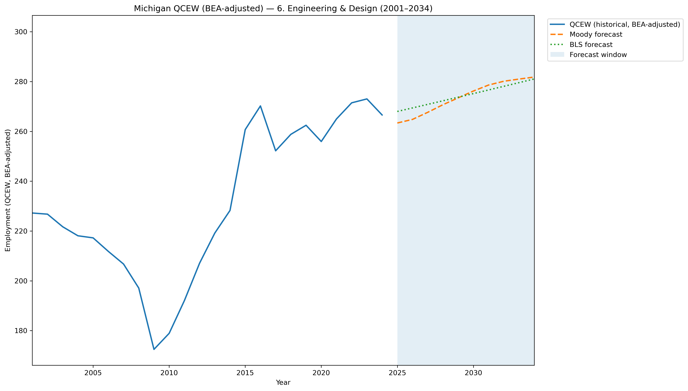
Mi Qcew Bea Segment 6 Compare 2001 2034
Source: EV Transition Forecasts

Slide 13
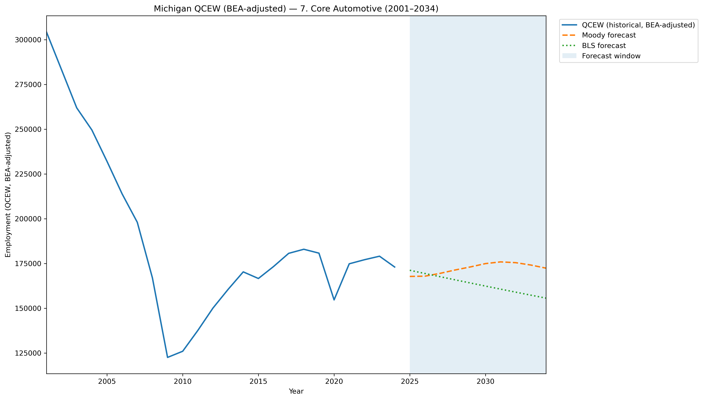
Mi Qcew Bea Segment 7 Compare 2001 2034
Source: EV Transition Forecasts

Slide 14
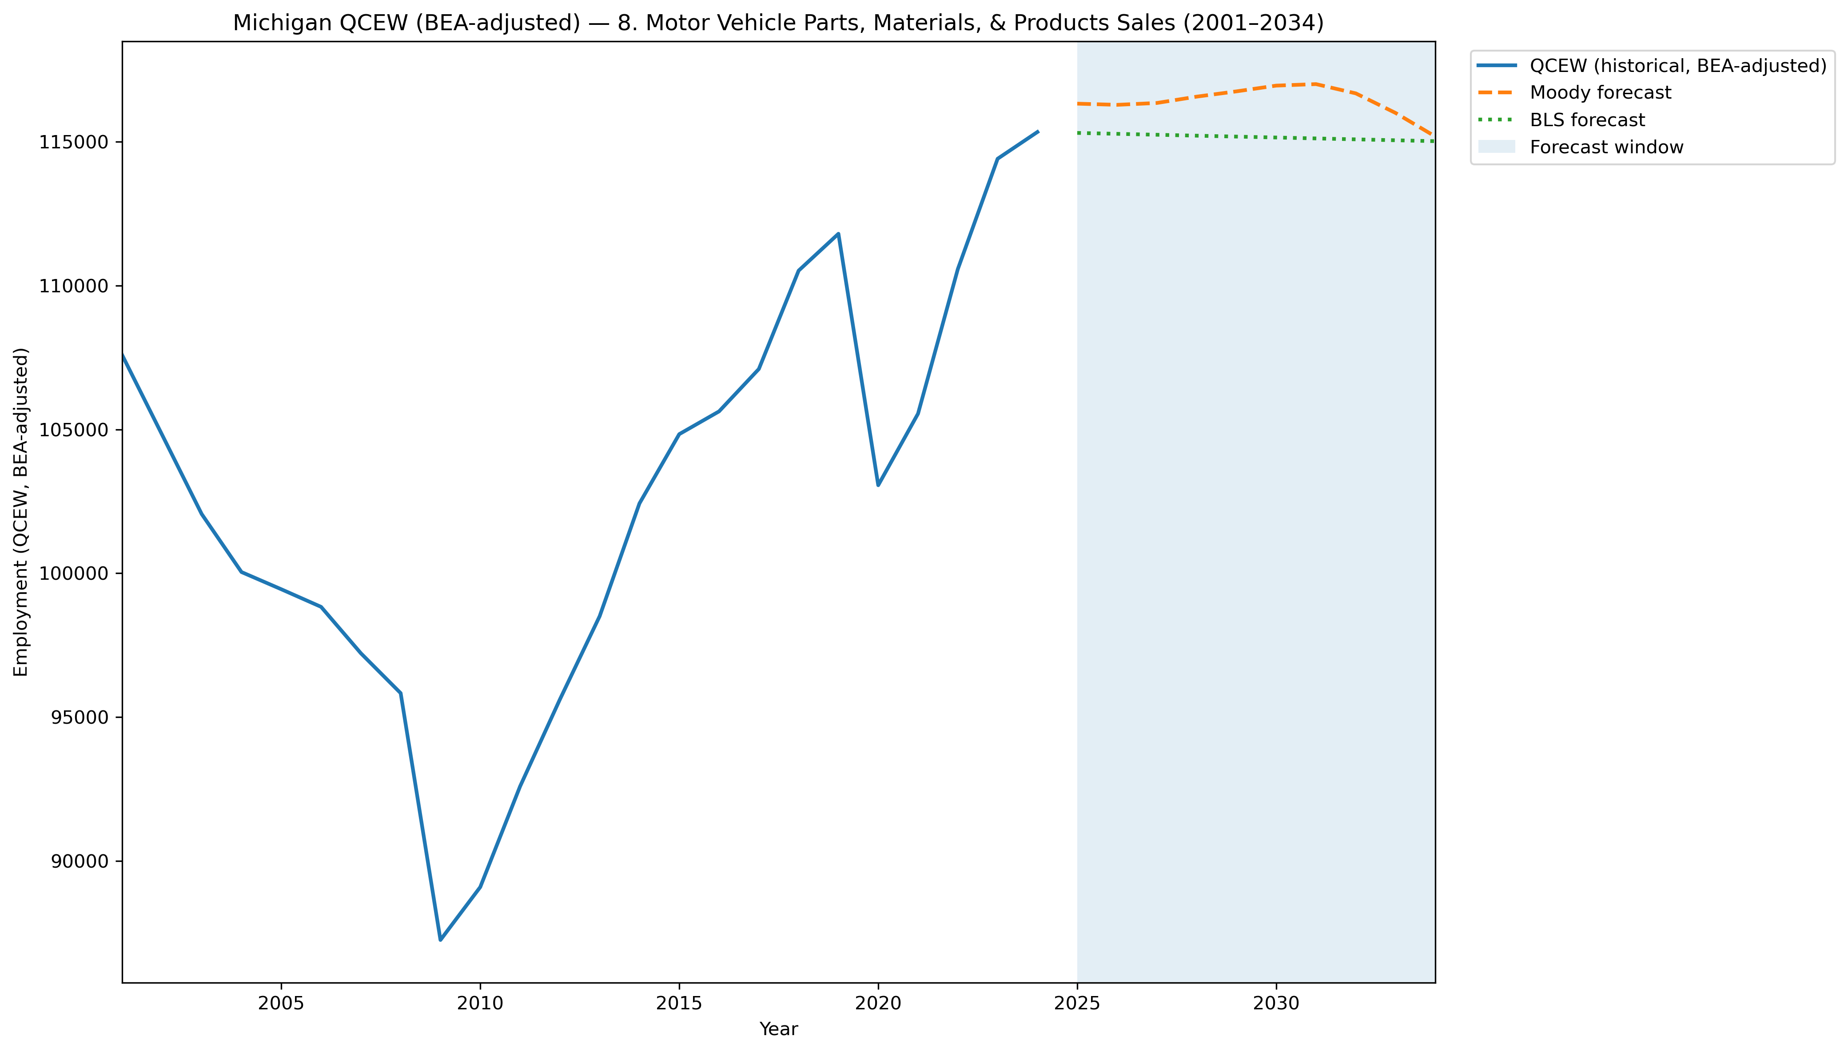
Mi Qcew Bea Segment 8 Compare 2001 2034
Source: EV Transition Forecasts

Slide 15
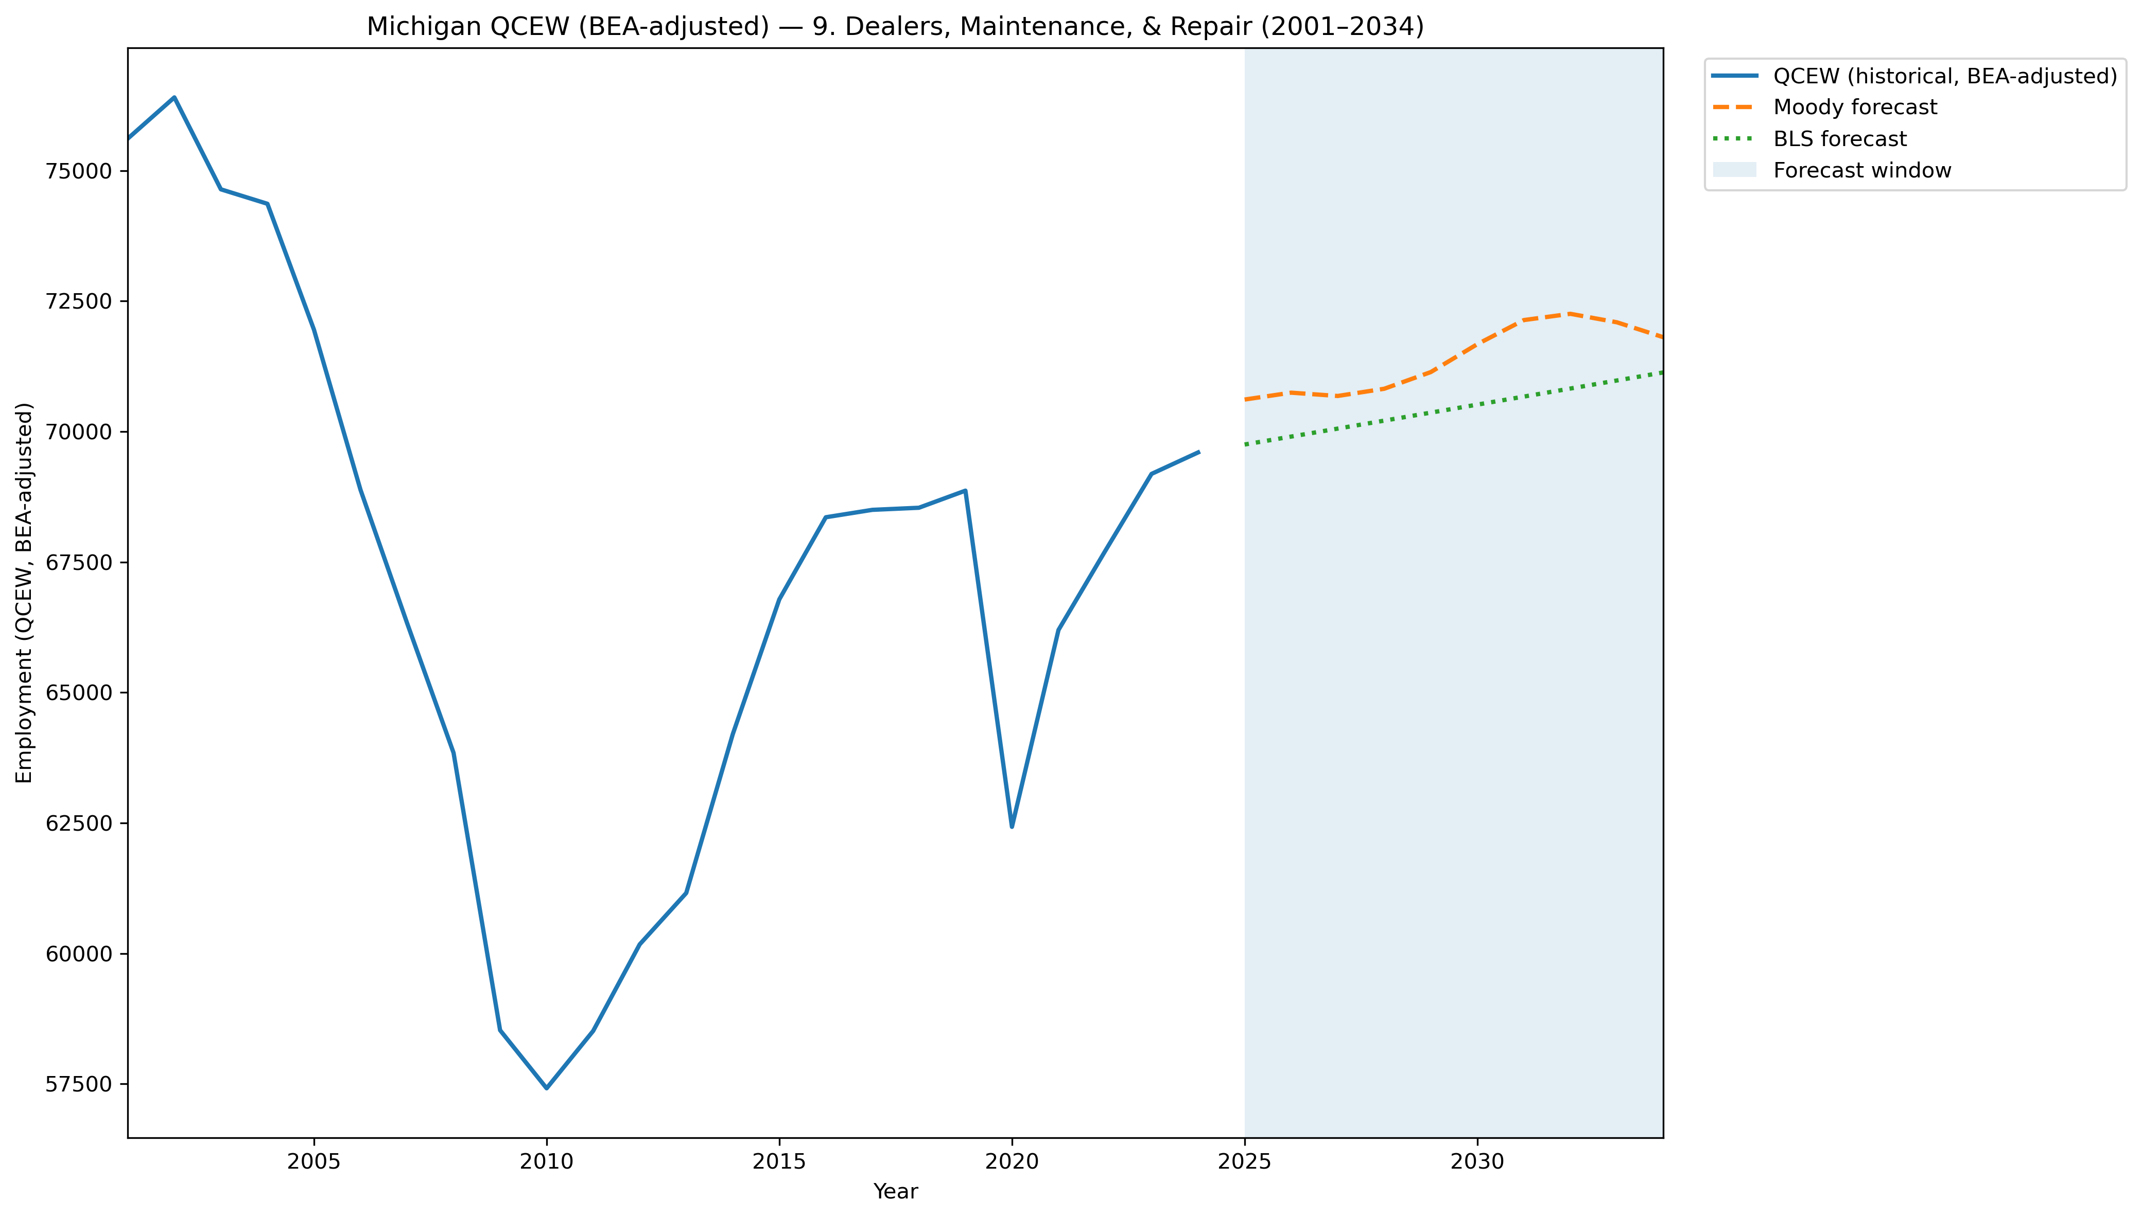
Mi Qcew Bea Segment 9 Compare 2001 2034
Source: EV Transition Forecasts

Slide 16
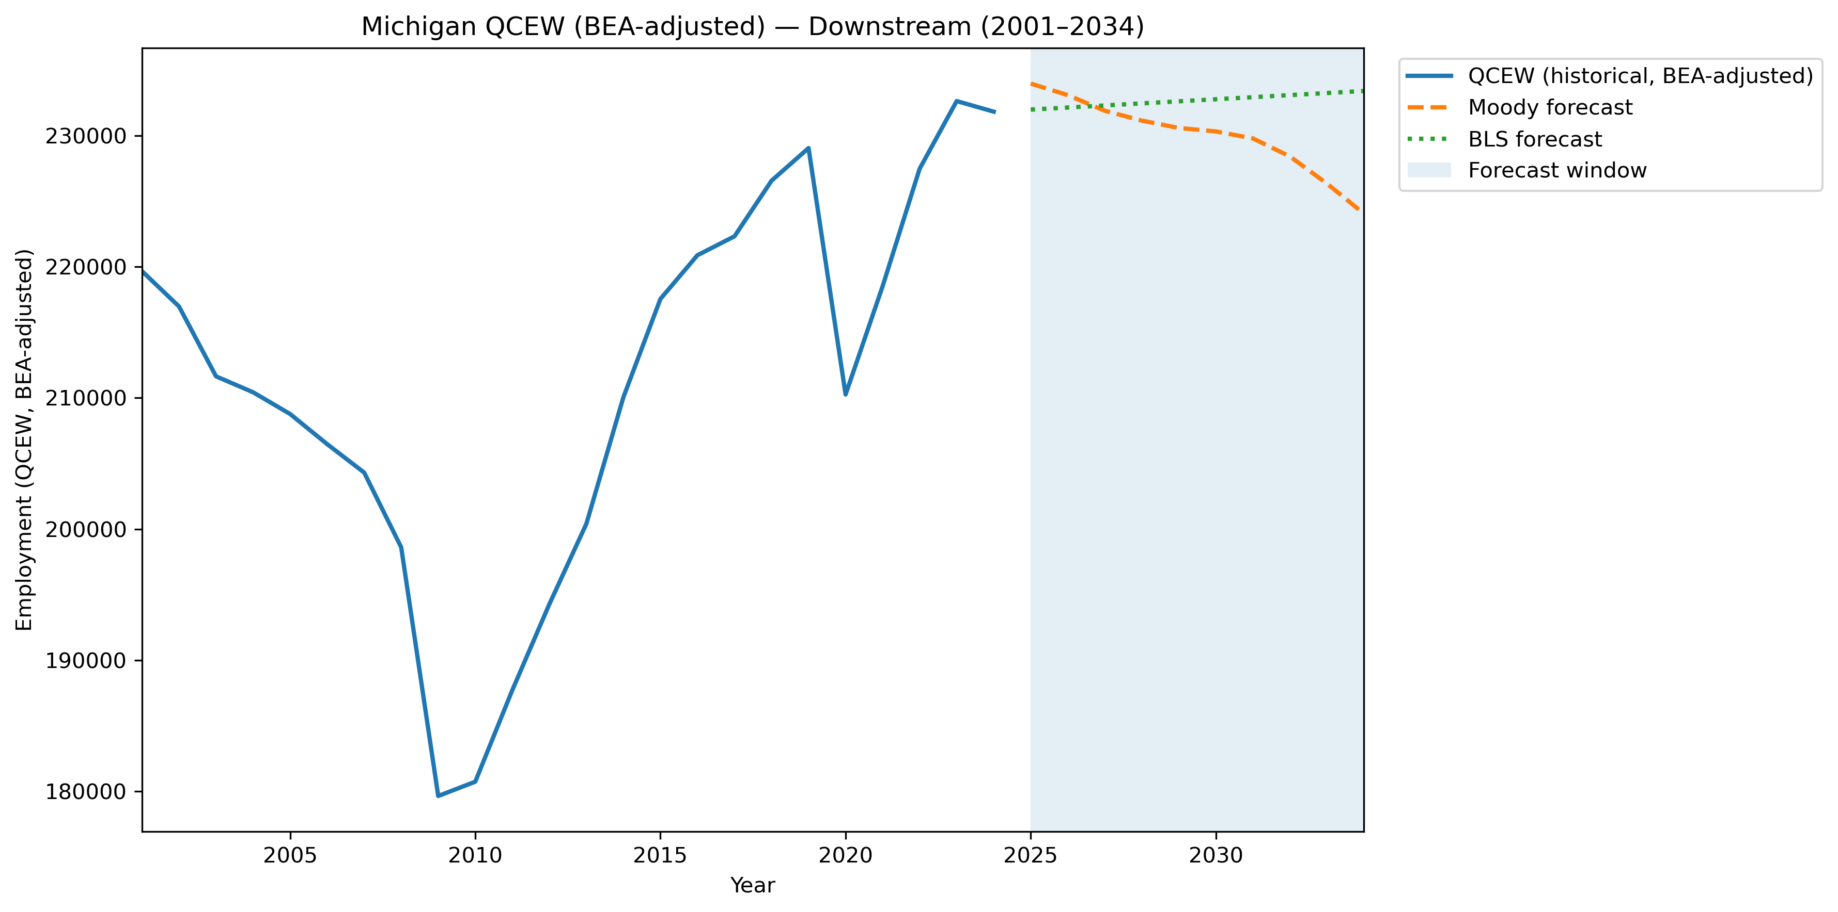
Mi Qcew Bea Stage Downstream Compare 2001 2034
Source: EV Transition Forecasts

Slide 17
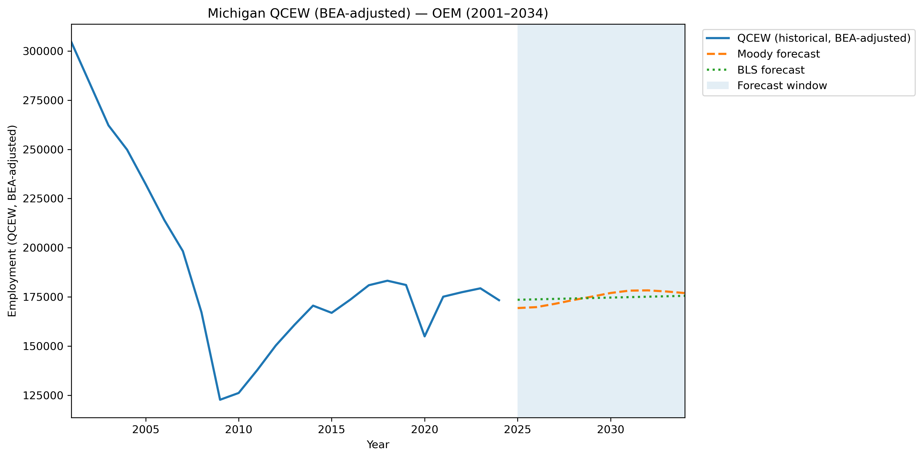
Mi Qcew Bea Stage Oem Compare 2001 2034
Source: EV Transition Forecasts

Slide 18
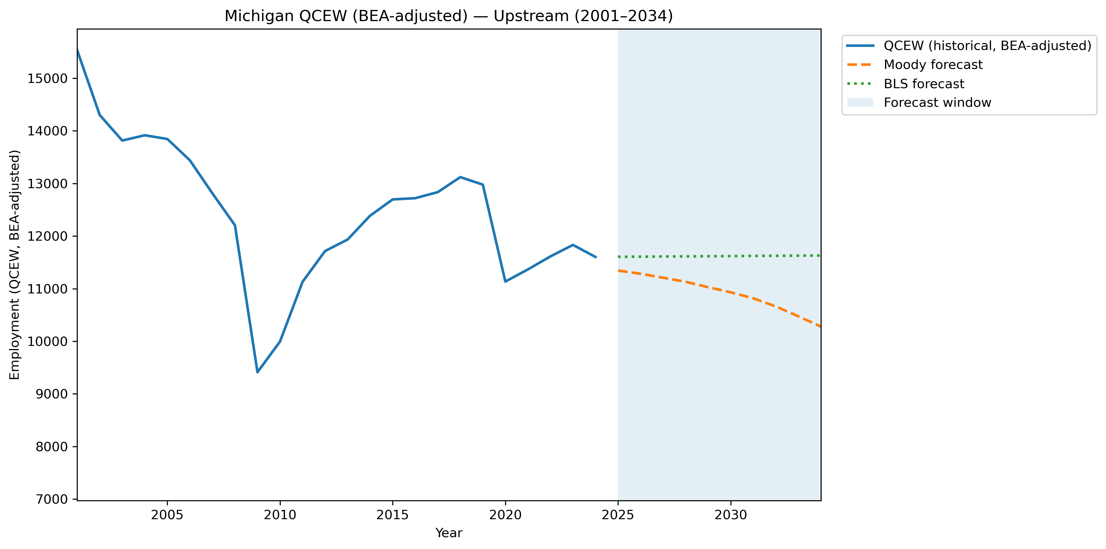
Mi Qcew Bea Stage Upstream Compare 2001 2034
Source: EV Transition Forecasts

Slide 19
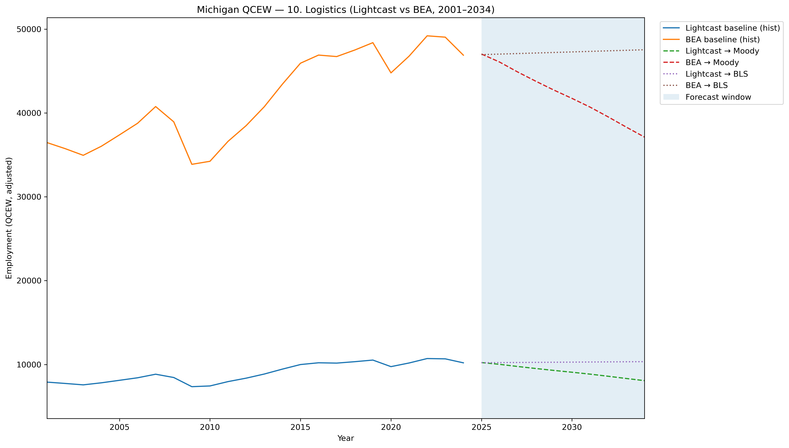
Mi Qcew Compare Segment 10 Lightcast Vs Bea 2001 2034
Source: EV Transition Forecasts

Slide 20
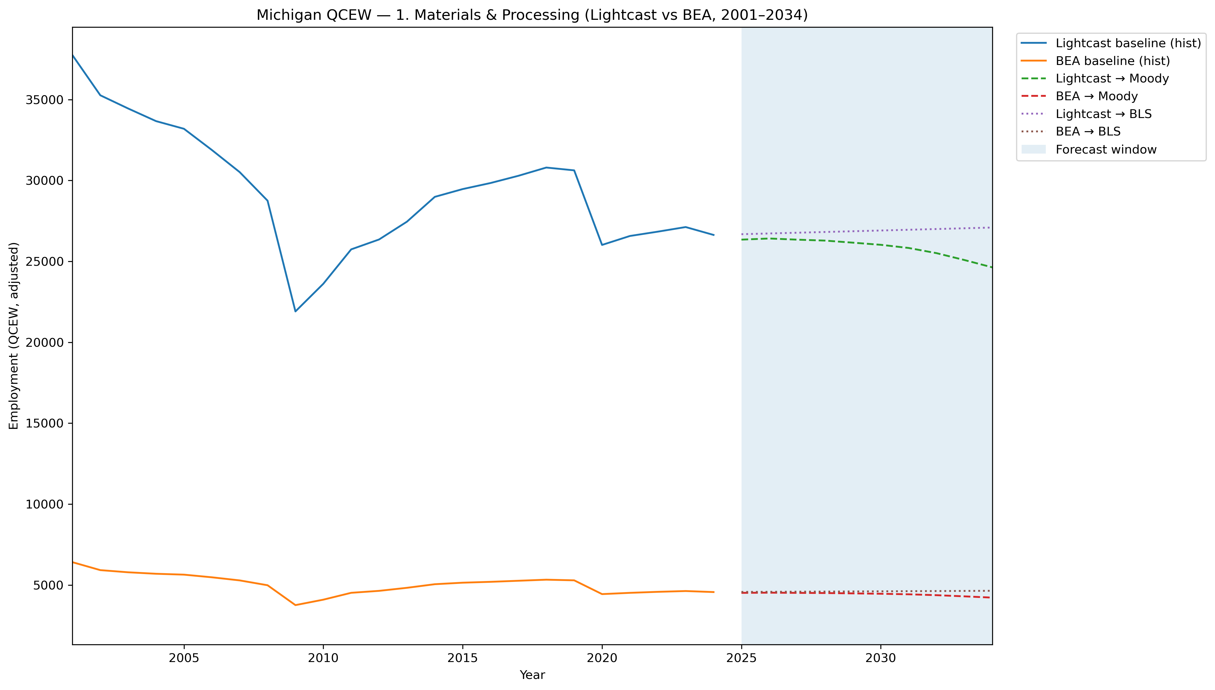
Mi Qcew Compare Segment 1 Lightcast Vs Bea 2001 2034
Source: EV Transition Forecasts

Slide 21
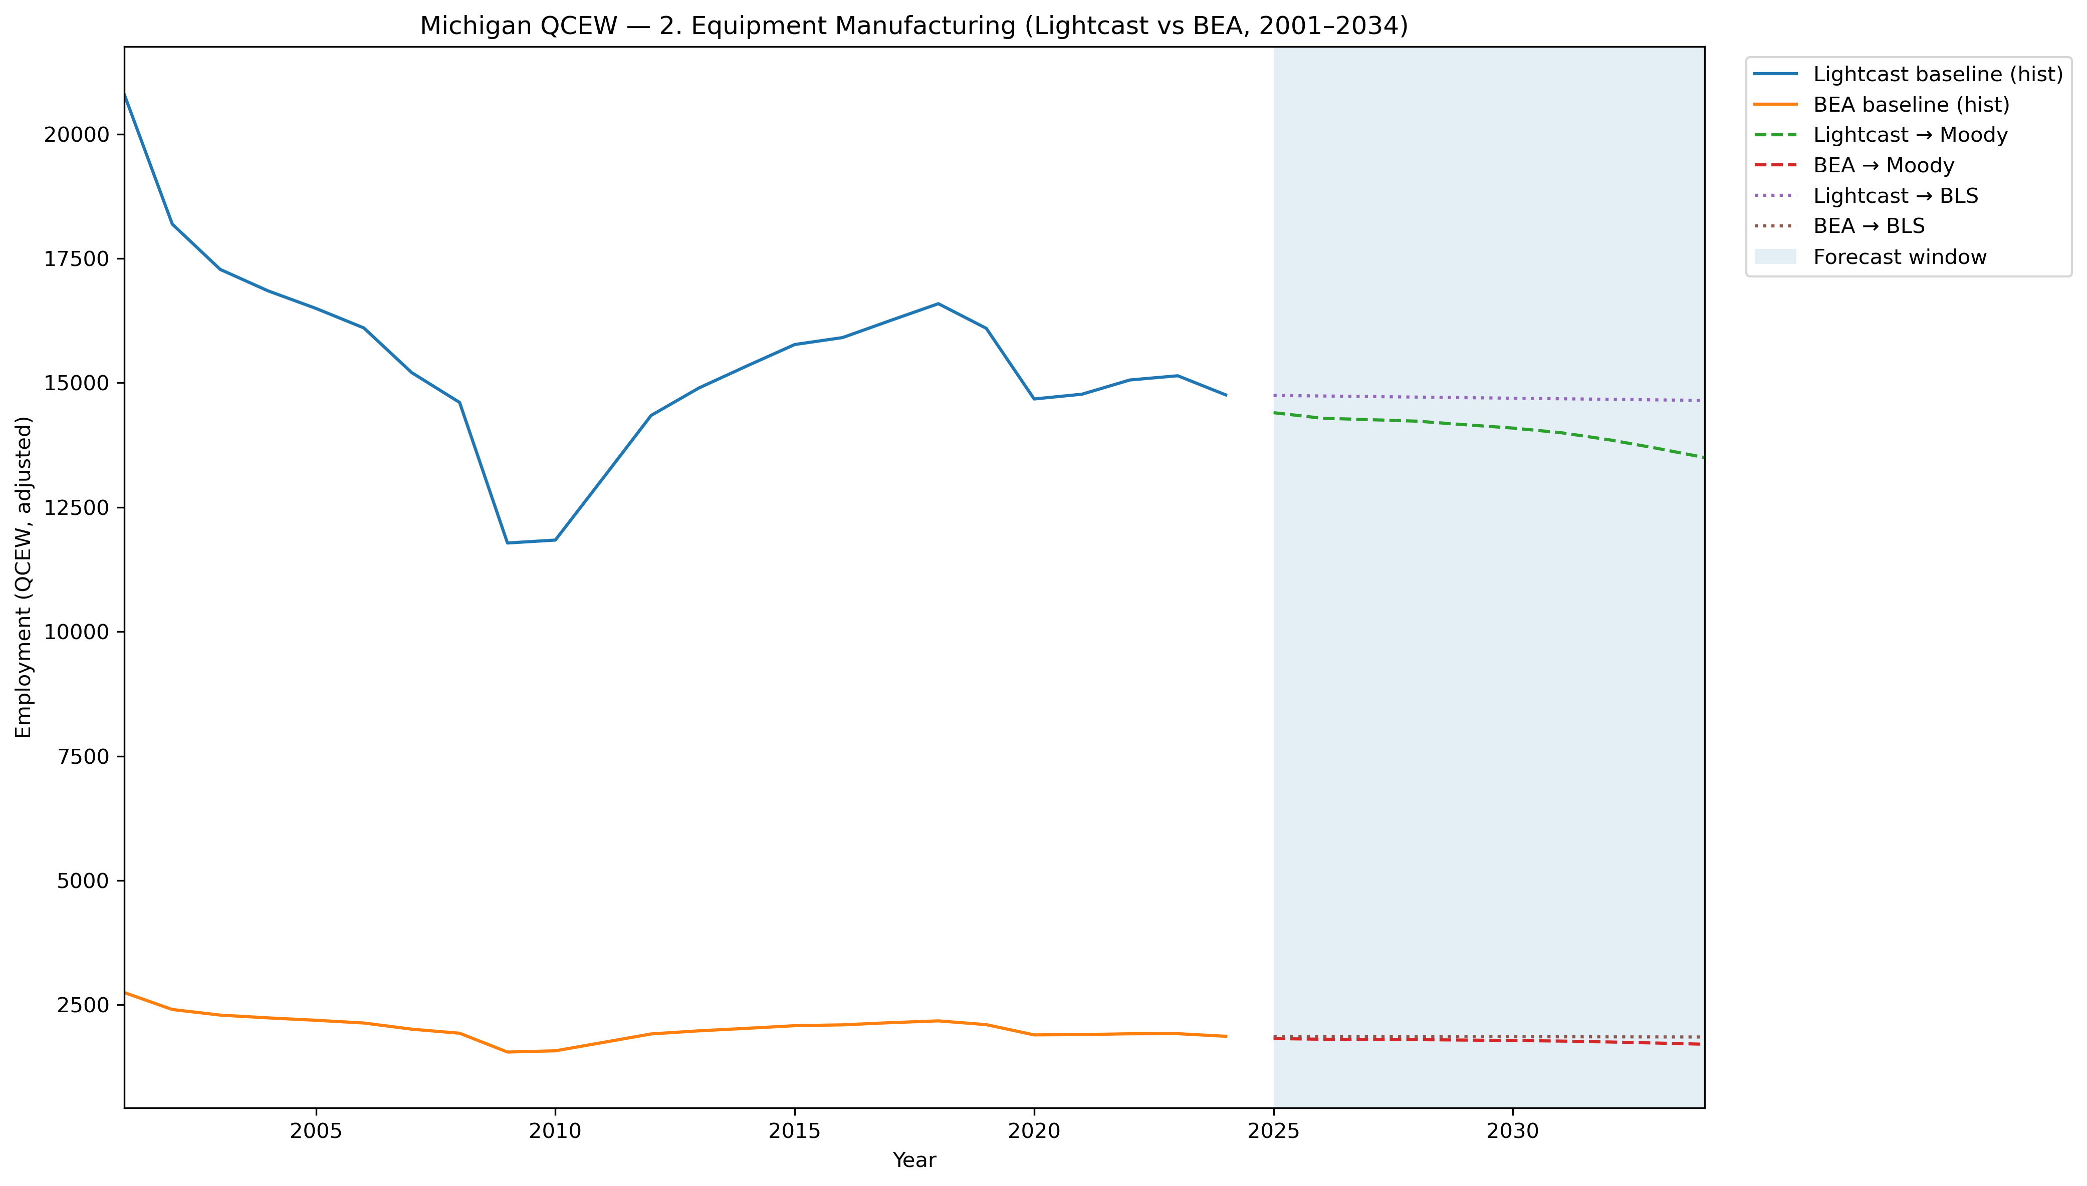
Mi Qcew Compare Segment 2 Lightcast Vs Bea 2001 2034
Source: EV Transition Forecasts

Slide 22
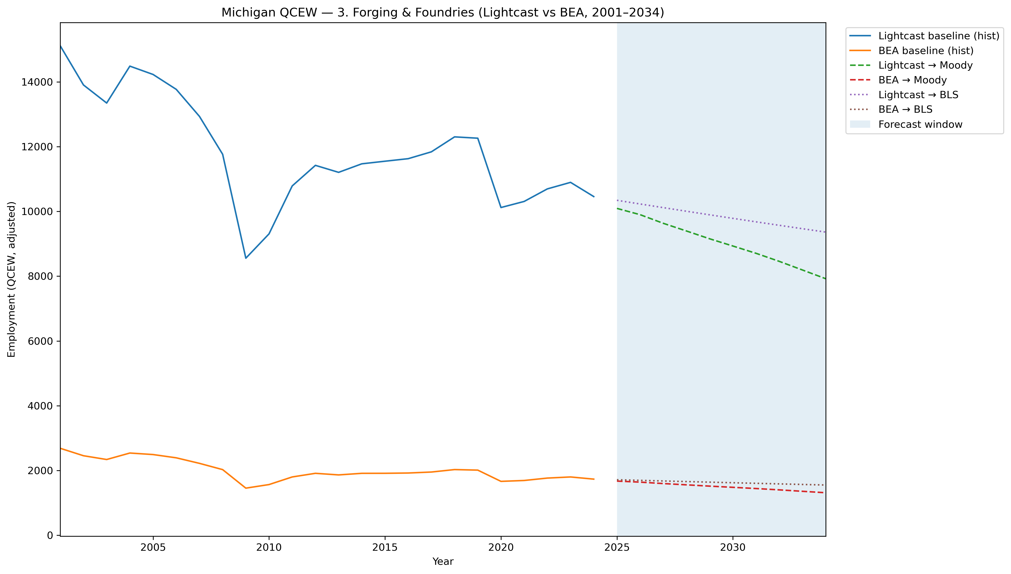
Mi Qcew Compare Segment 3 Lightcast Vs Bea 2001 2034
Source: EV Transition Forecasts

Slide 23
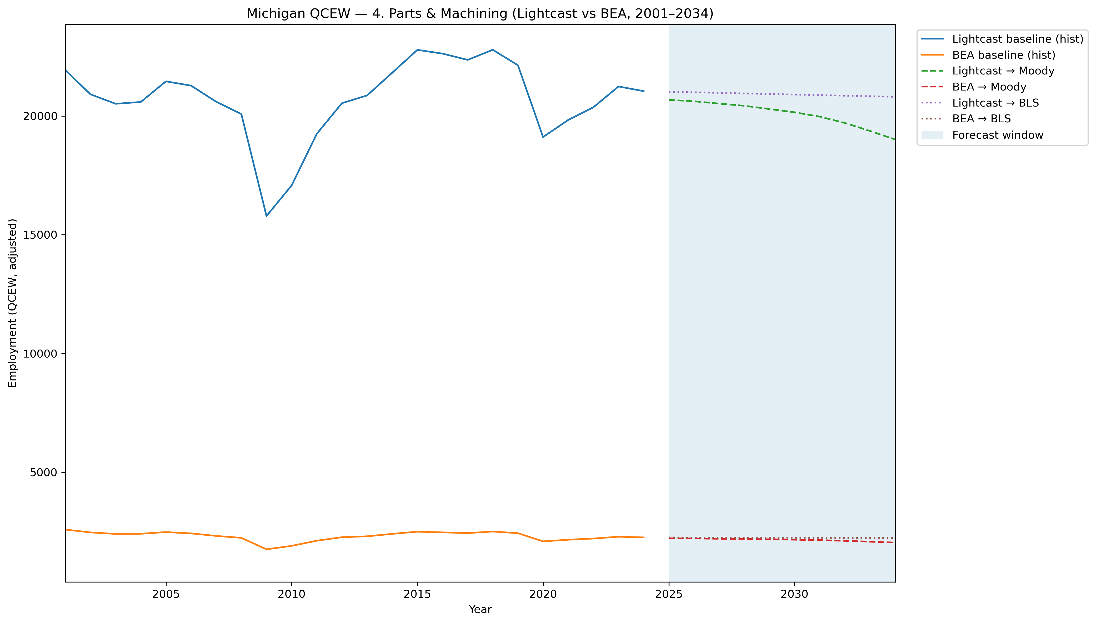
Mi Qcew Compare Segment 4 Lightcast Vs Bea 2001 2034
Source: EV Transition Forecasts

Slide 24
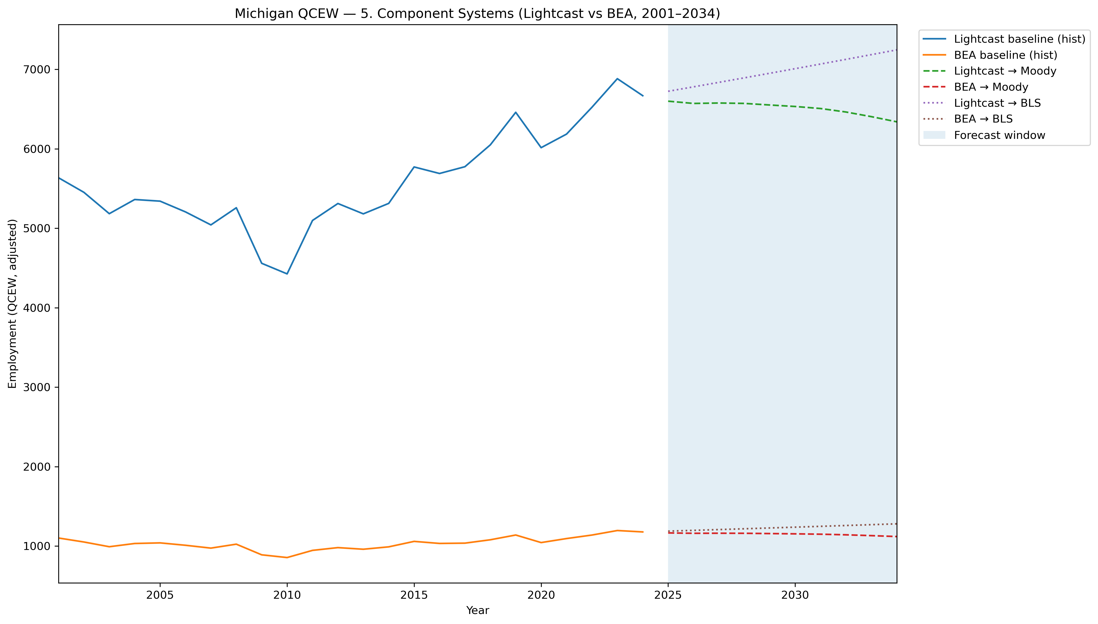
Mi Qcew Compare Segment 5 Lightcast Vs Bea 2001 2034
Source: EV Transition Forecasts

Slide 25
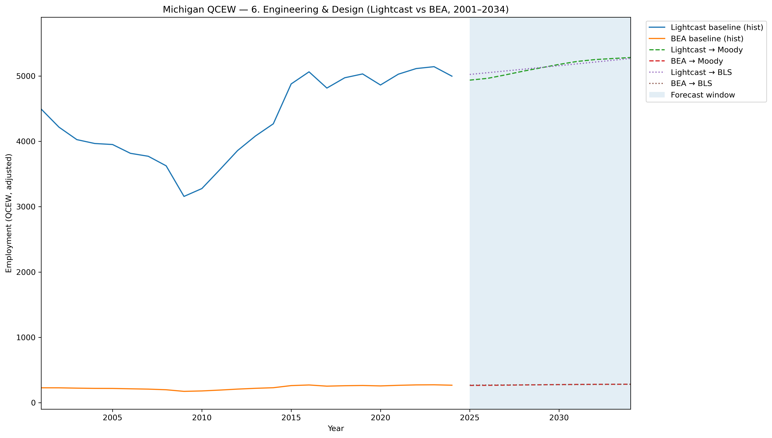
Mi Qcew Compare Segment 6 Lightcast Vs Bea 2001 2034
Source: EV Transition Forecasts

Slide 26
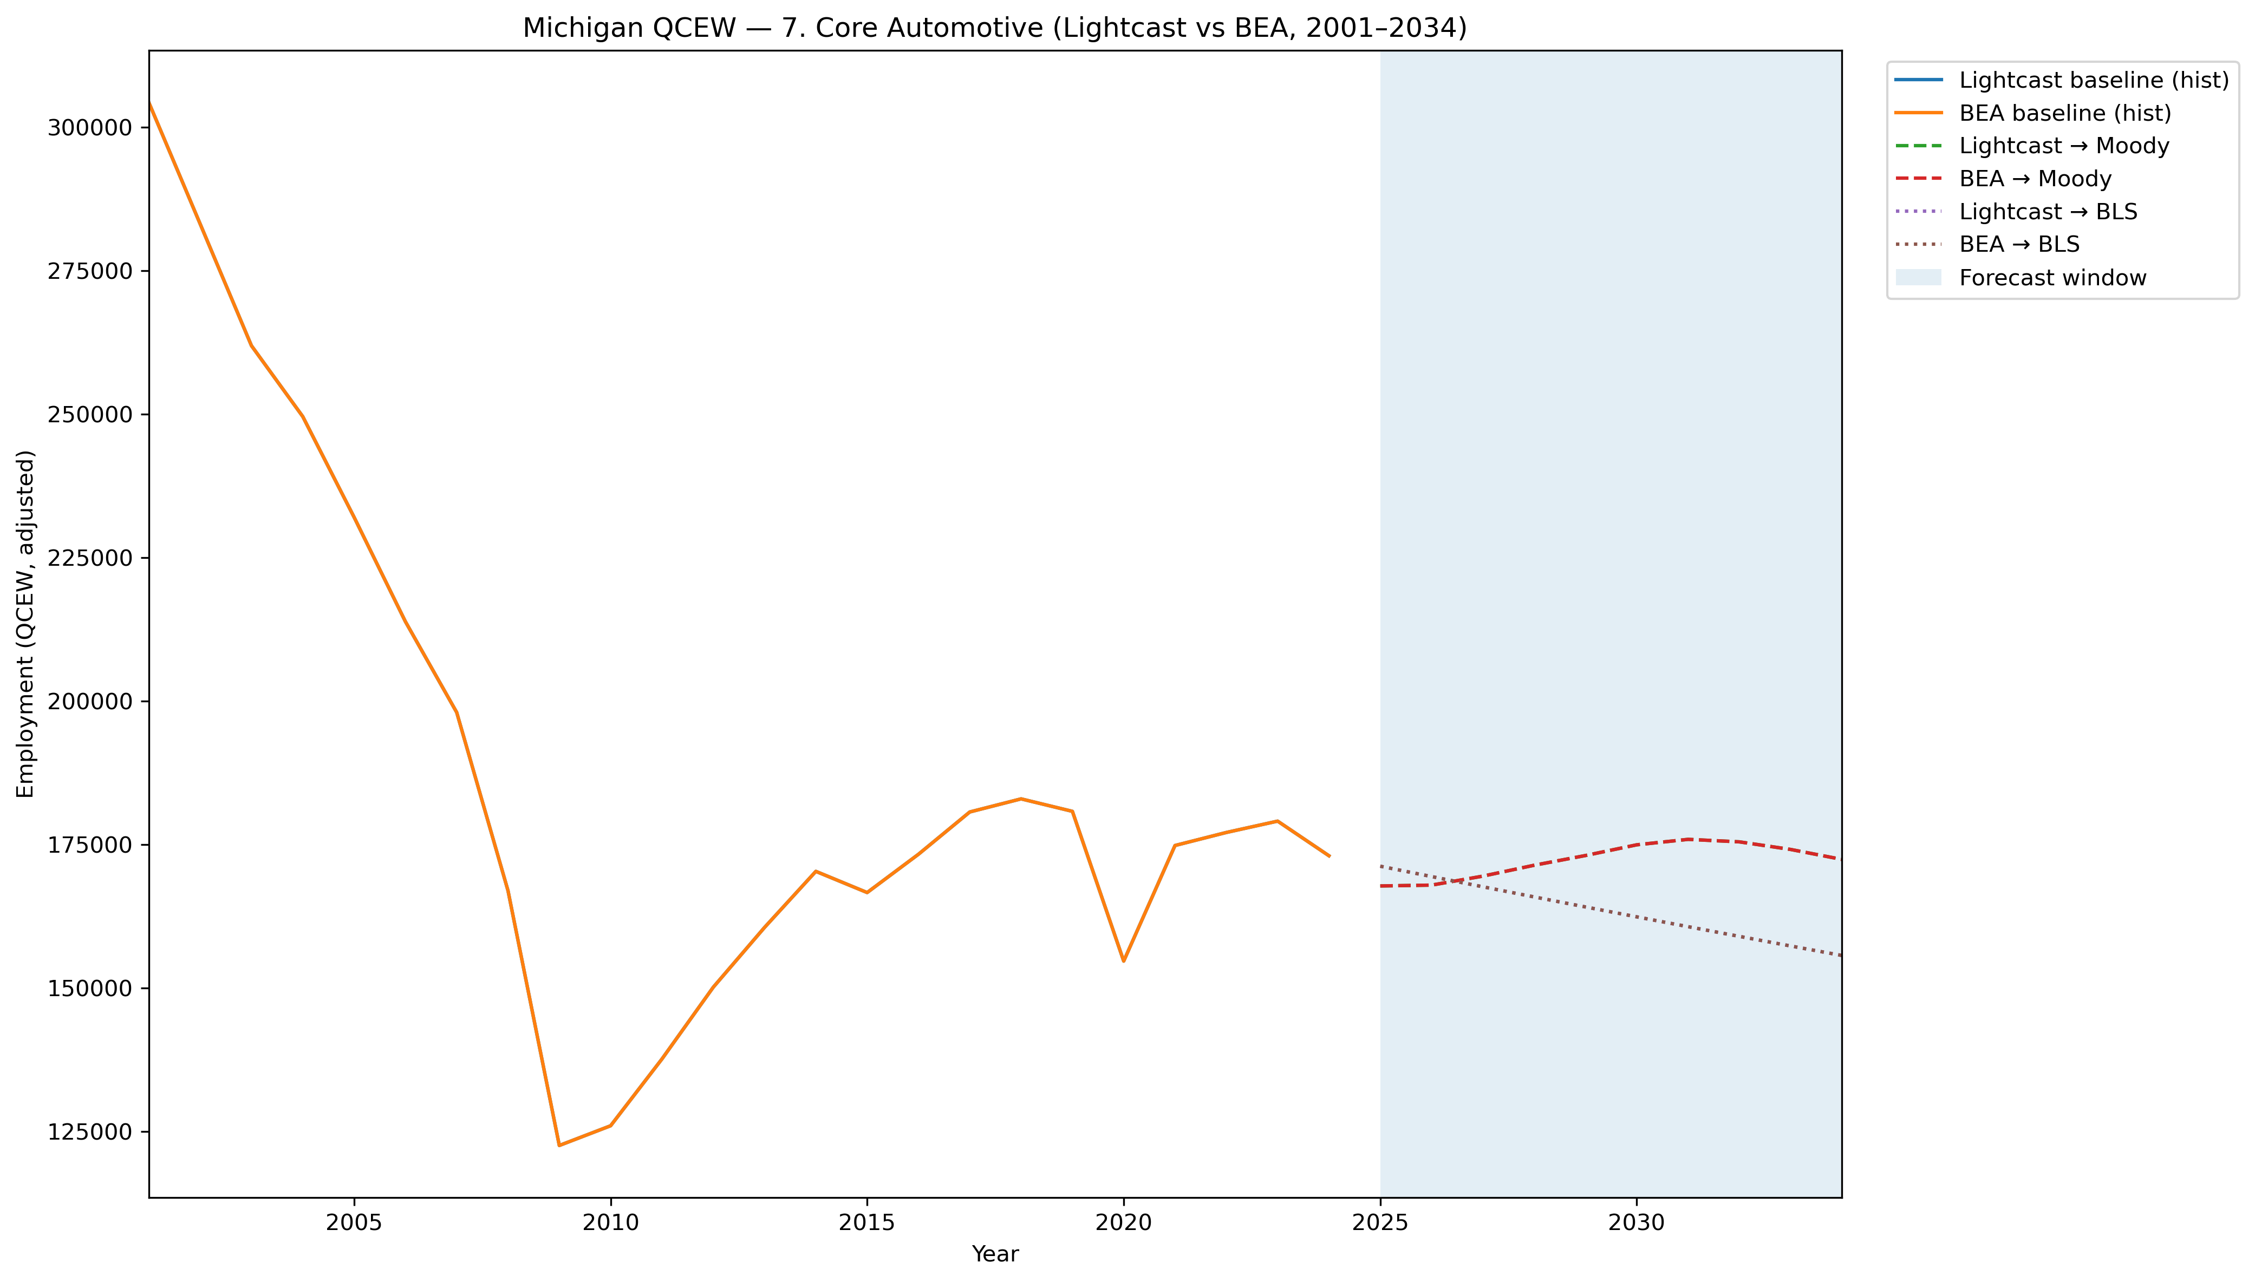
Mi Qcew Compare Segment 7 Lightcast Vs Bea 2001 2034
Source: EV Transition Forecasts

Slide 27
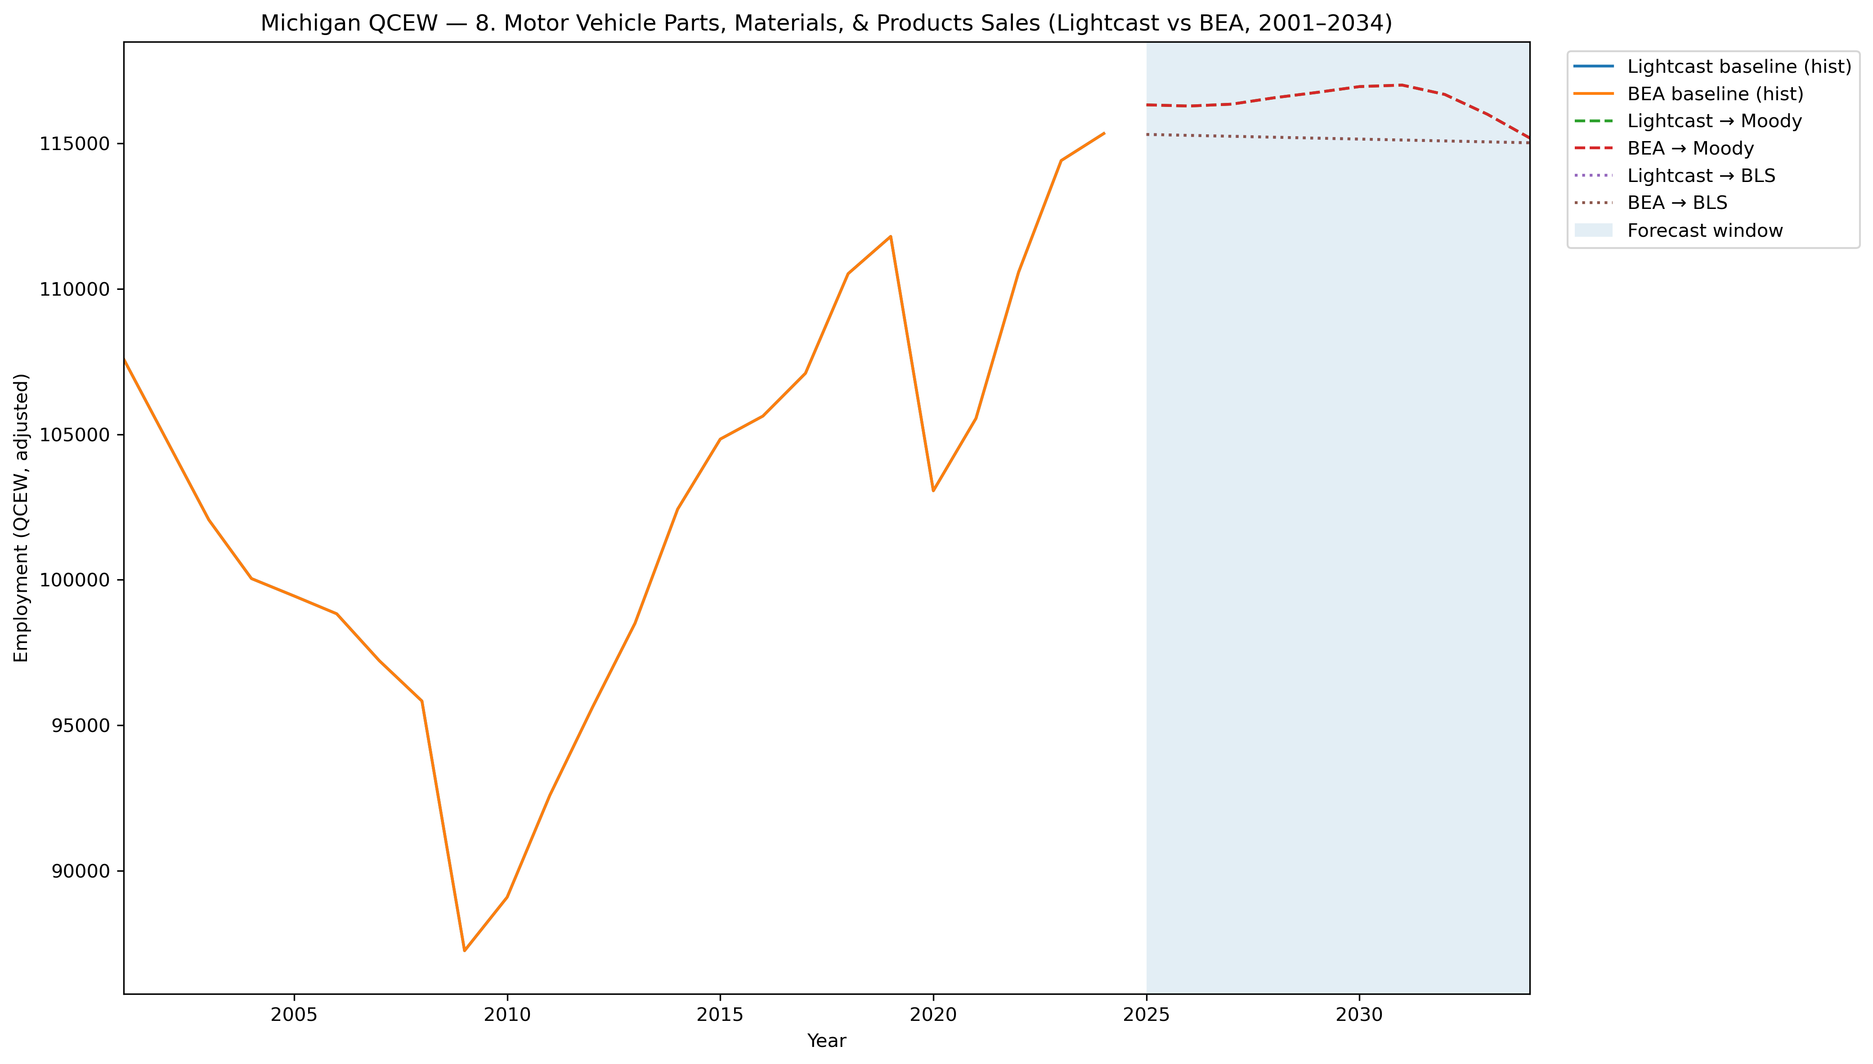
Mi Qcew Compare Segment 8 Lightcast Vs Bea 2001 2034
Source: EV Transition Forecasts

Slide 28
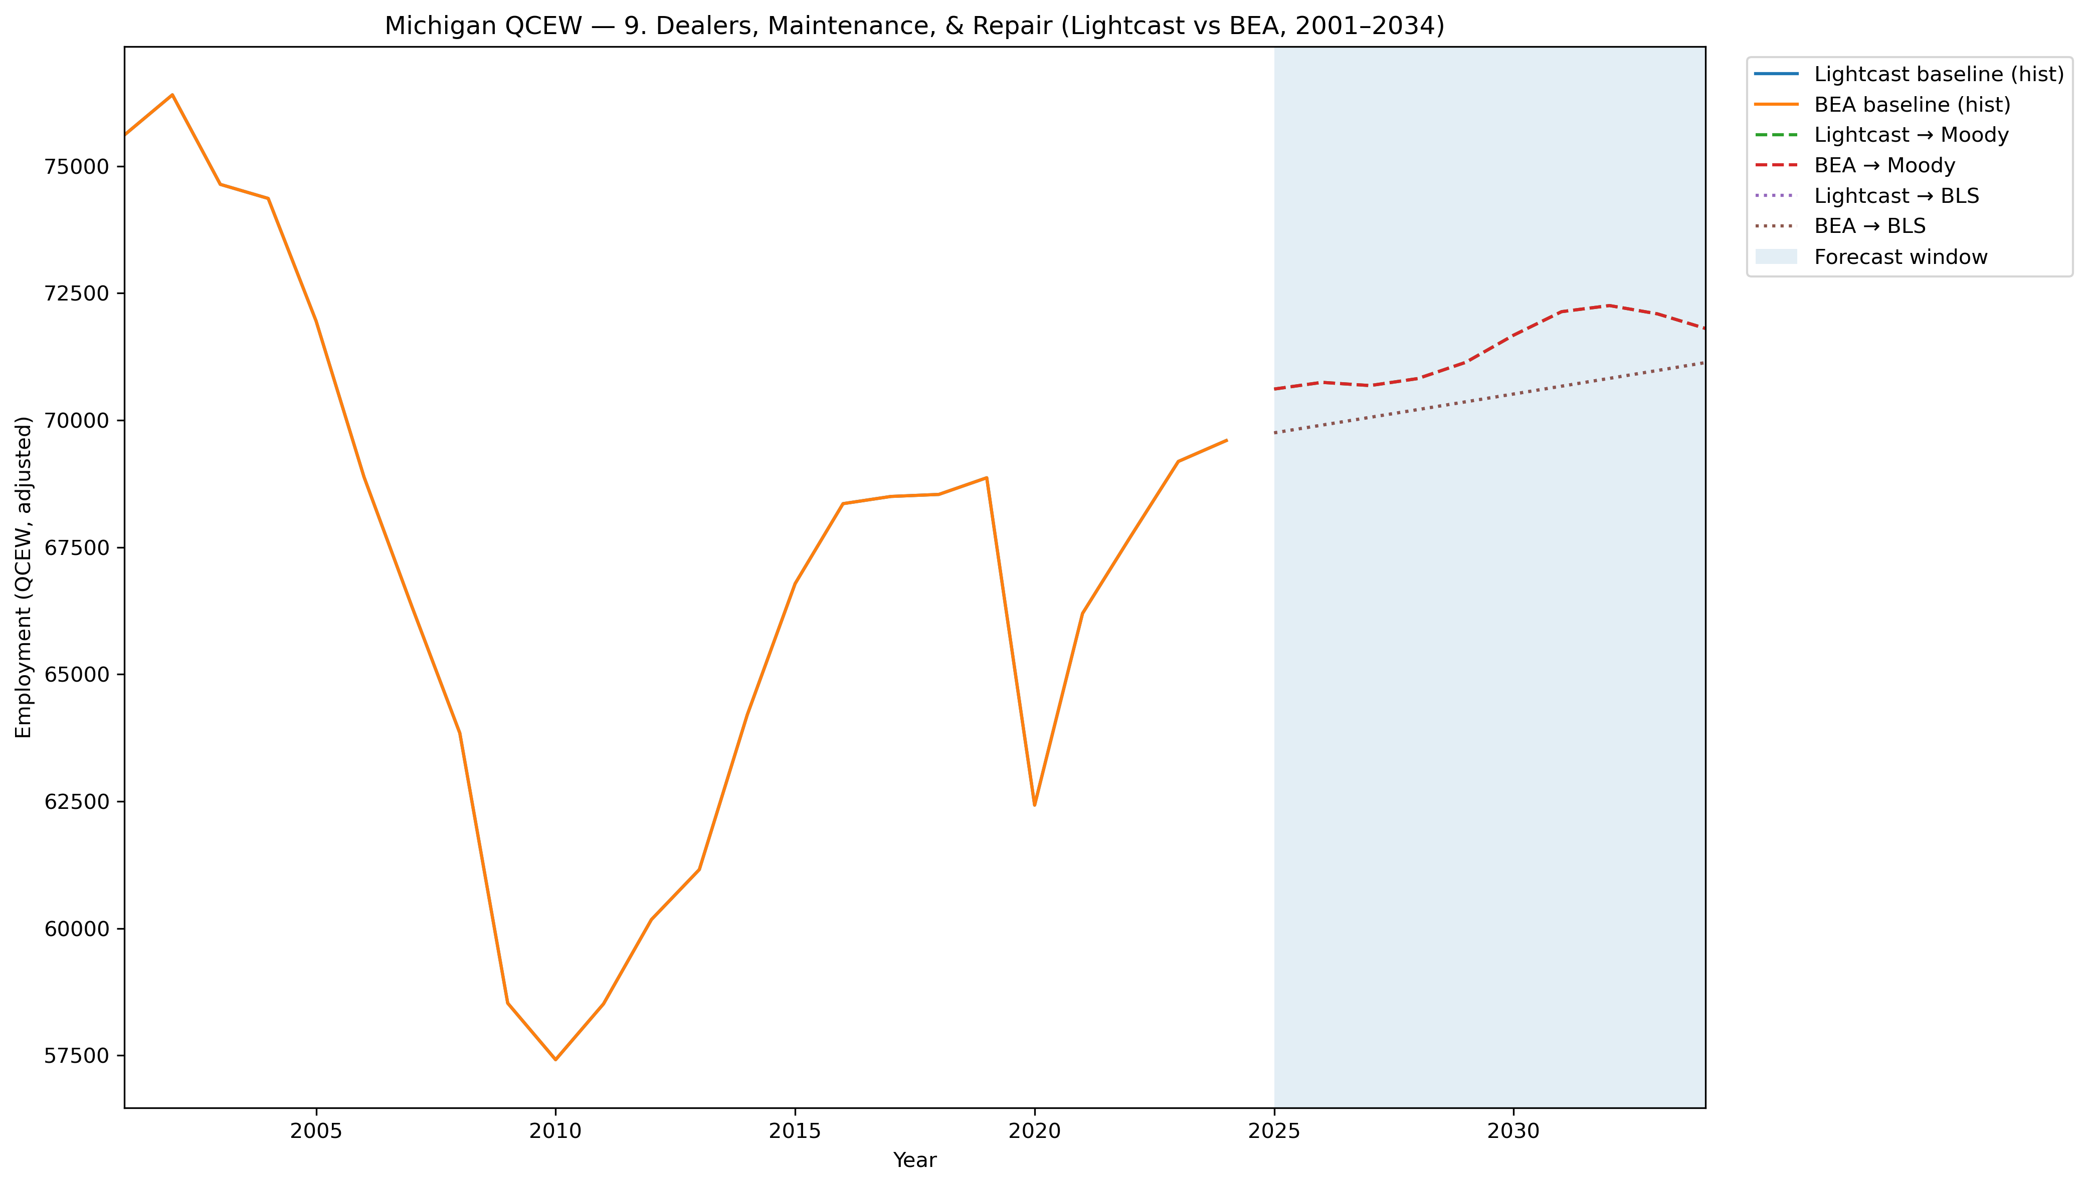
Mi Qcew Compare Segment 9 Lightcast Vs Bea 2001 2034
Source: EV Transition Forecasts

Slide 29
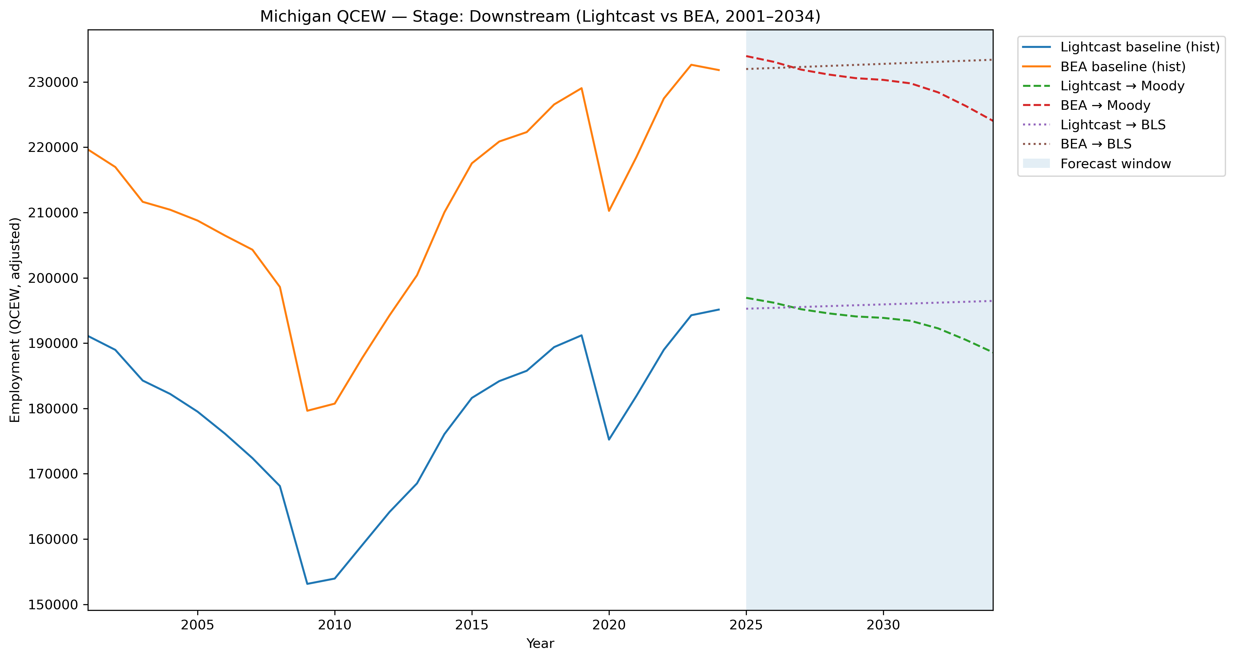
Mi Qcew Compare Stage Downstream Lightcast Vs Bea 2001 2034
Source: EV Transition Forecasts

Slide 30
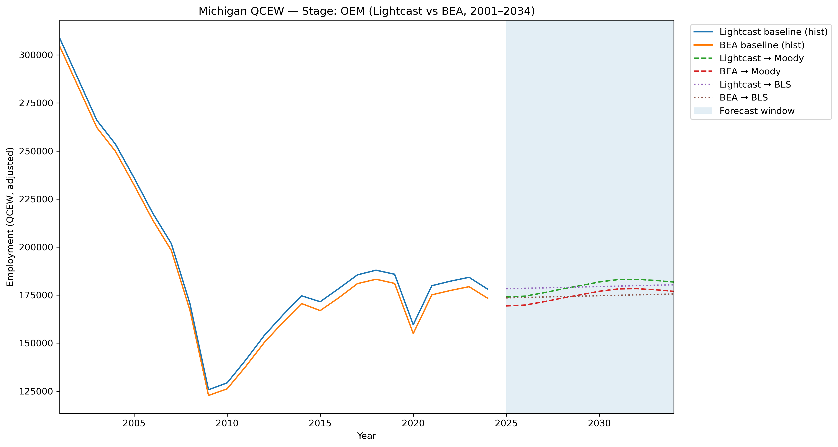
Mi Qcew Compare Stage Oem Lightcast Vs Bea 2001 2034
Source: EV Transition Forecasts

Slide 31
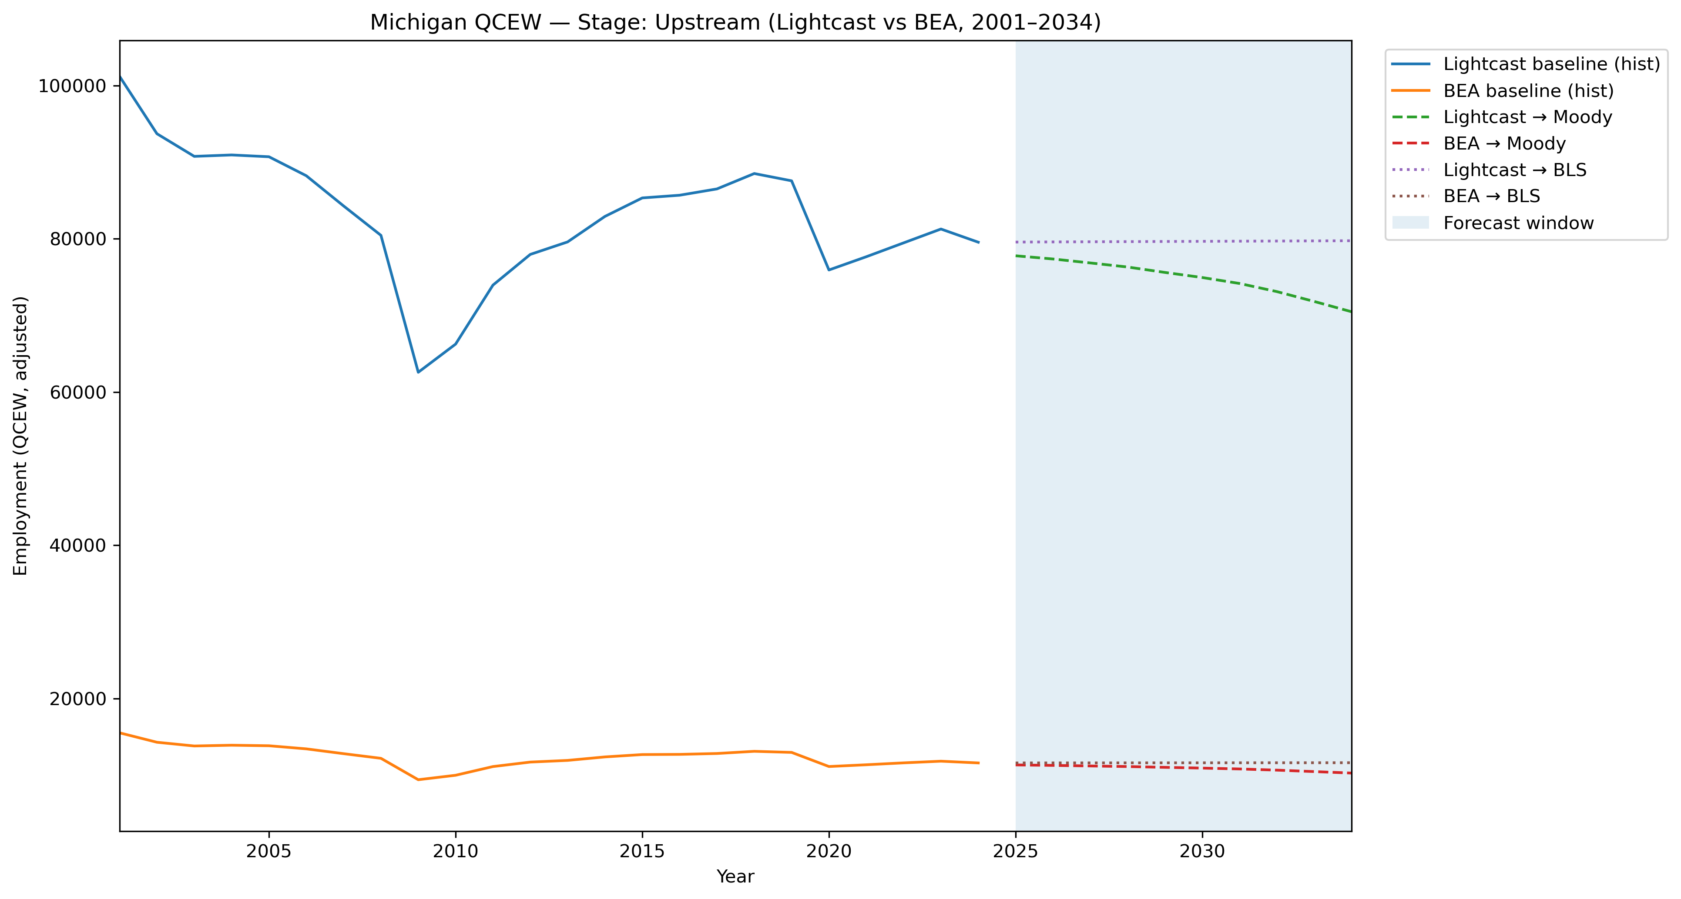
Mi Qcew Compare Stage Upstream Lightcast Vs Bea 2001 2034
Source: EV Transition Forecasts

Slide 32
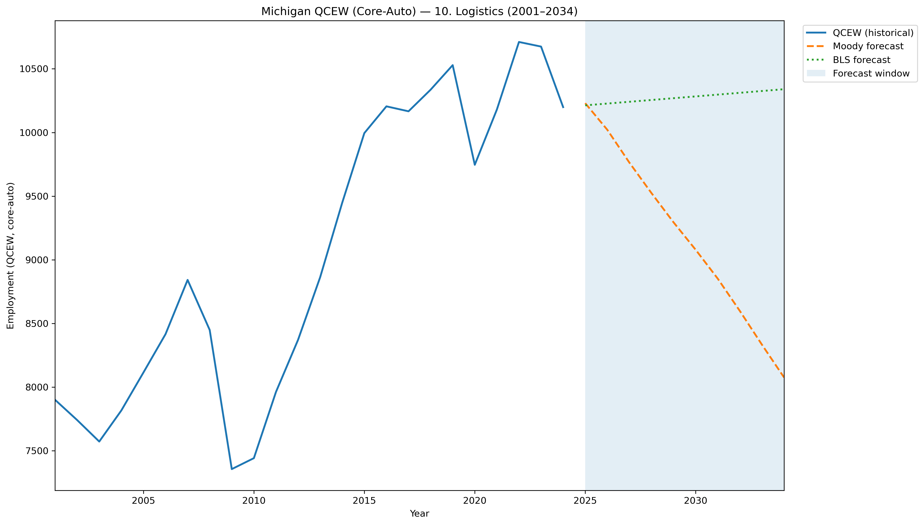
Mi Qcew Coreauto Segment 10 Compare 2001 2034
Source: EV Transition Forecasts

Slide 33
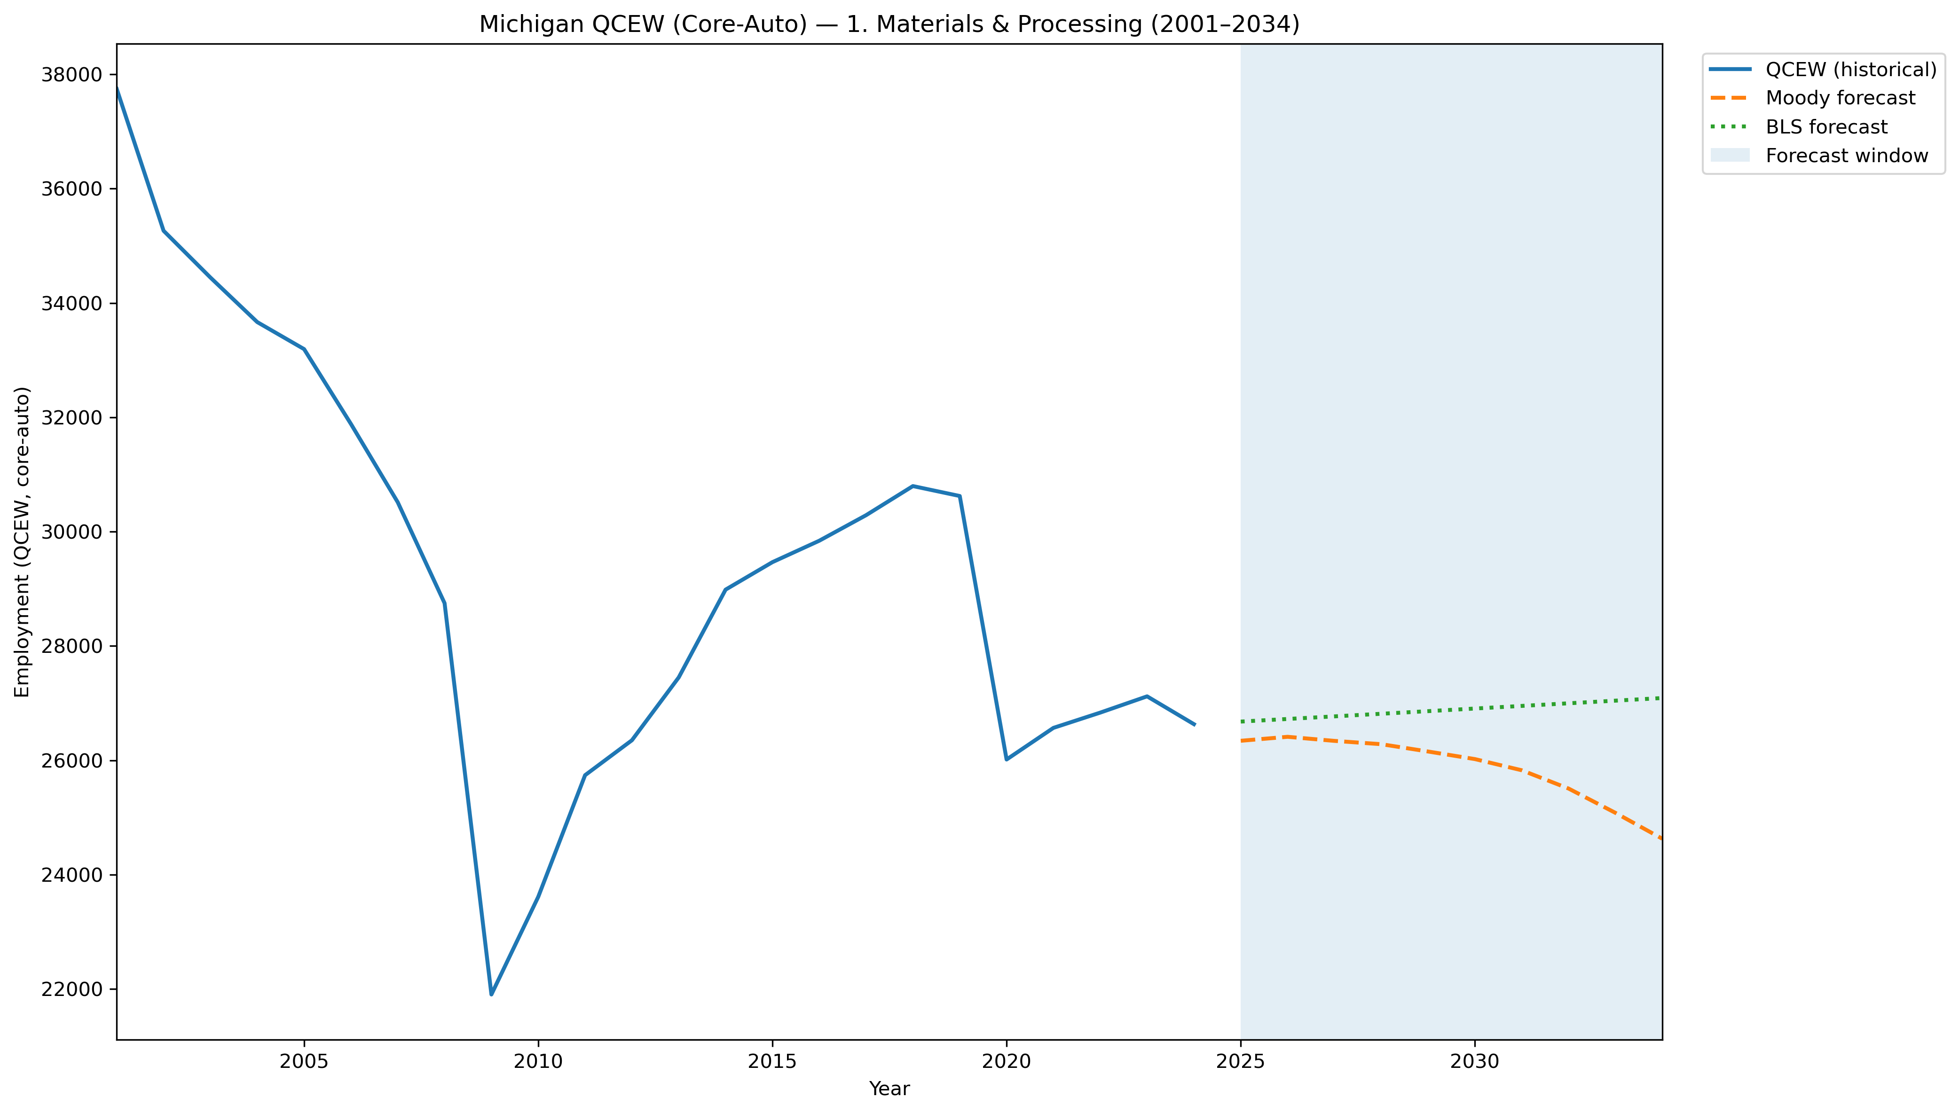
Mi Qcew Coreauto Segment 1 Compare 2001 2034
Source: EV Transition Forecasts

Slide 34
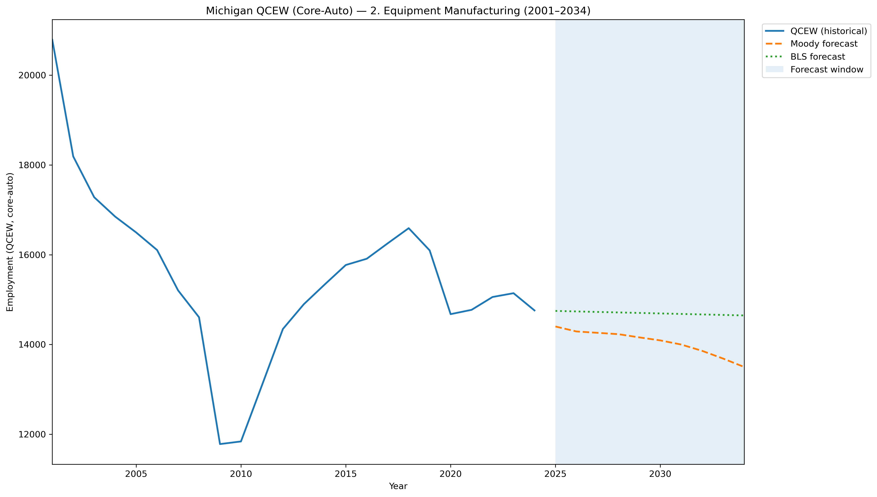
Mi Qcew Coreauto Segment 2 Compare 2001 2034
Source: EV Transition Forecasts

Slide 35
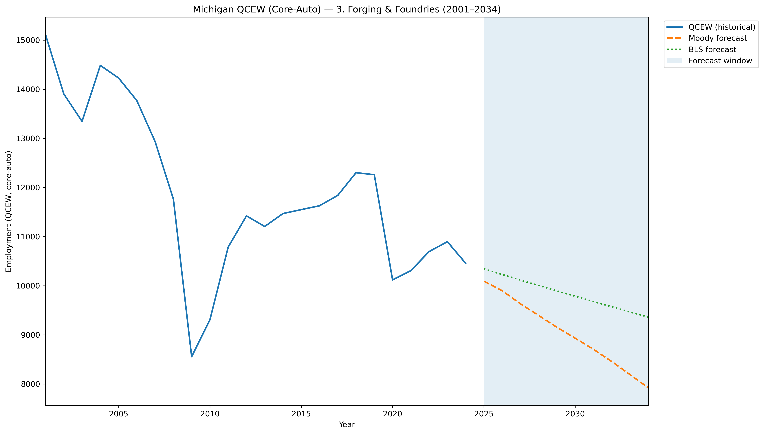
Mi Qcew Coreauto Segment 3 Compare 2001 2034
Source: EV Transition Forecasts

Slide 36
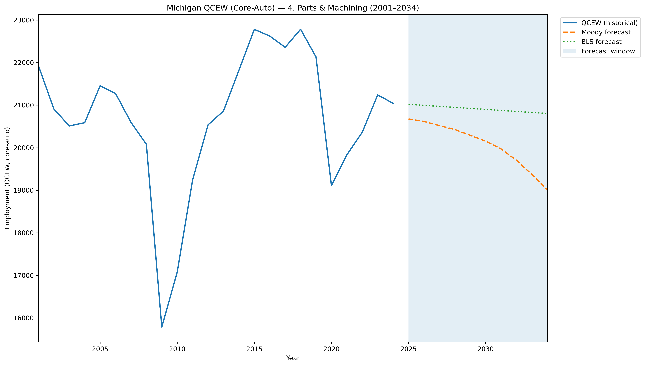
Mi Qcew Coreauto Segment 4 Compare 2001 2034
Source: EV Transition Forecasts

Slide 37
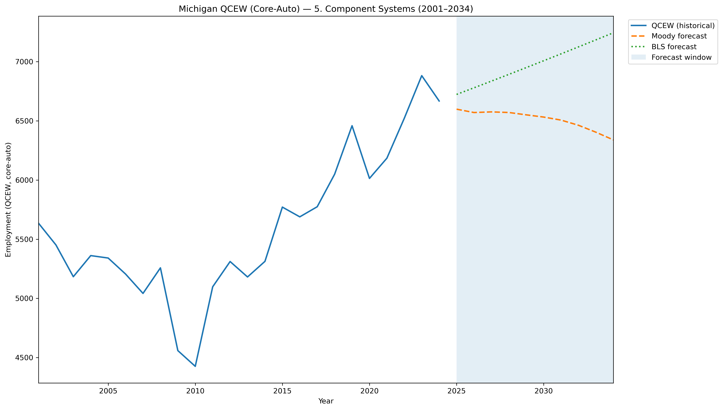
Mi Qcew Coreauto Segment 5 Compare 2001 2034
Source: EV Transition Forecasts

Slide 38
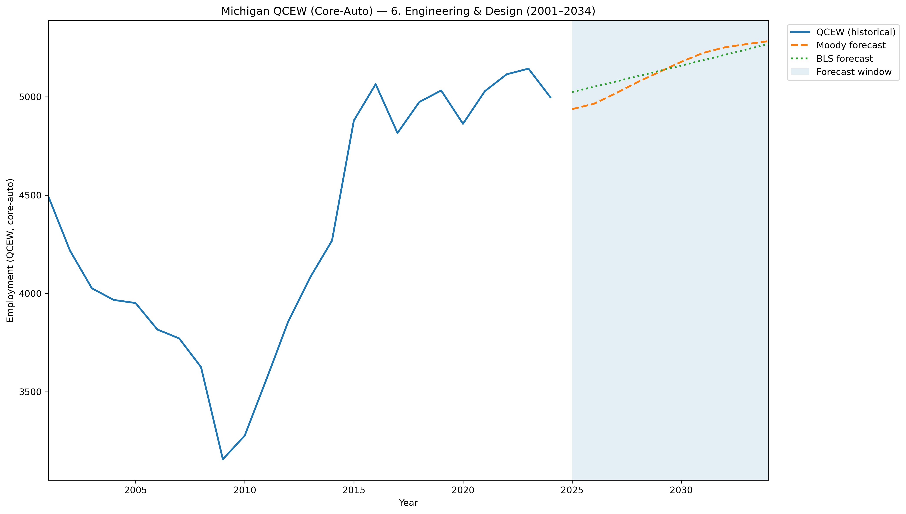
Mi Qcew Coreauto Segment 6 Compare 2001 2034
Source: EV Transition Forecasts

Slide 39
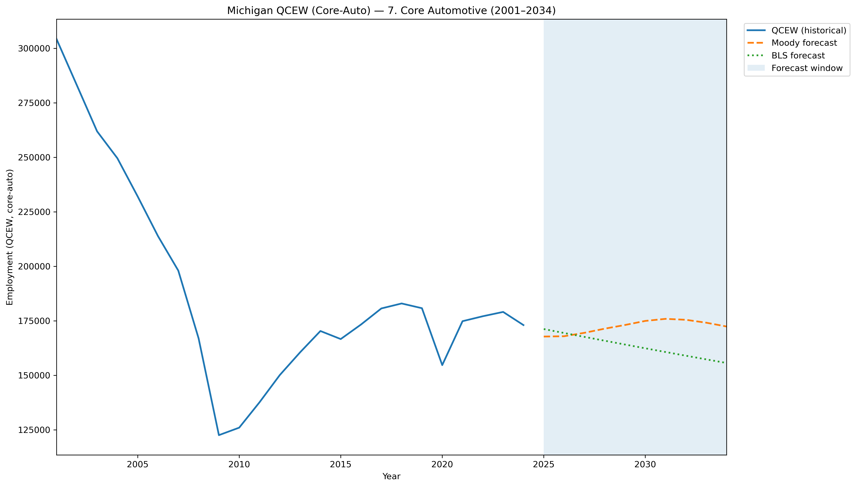
Mi Qcew Coreauto Segment 7 Compare 2001 2034
Source: EV Transition Forecasts

Slide 40
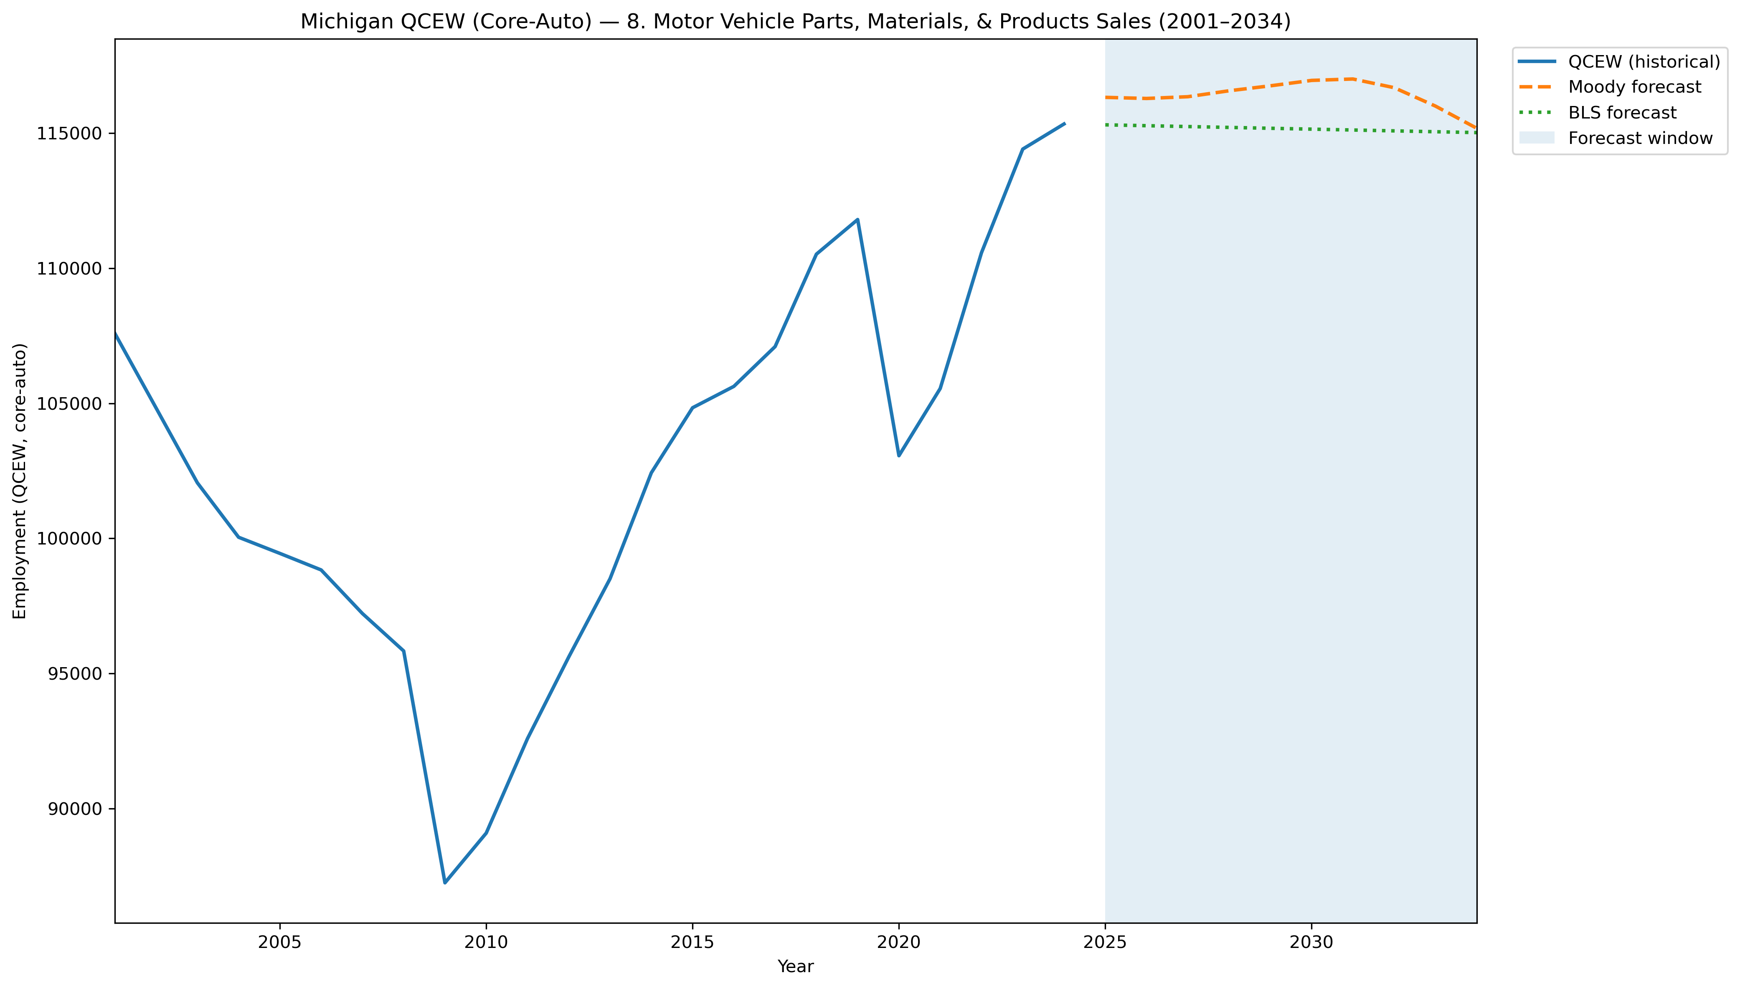
Mi Qcew Coreauto Segment 8 Compare 2001 2034
Source: EV Transition Forecasts

Slide 41
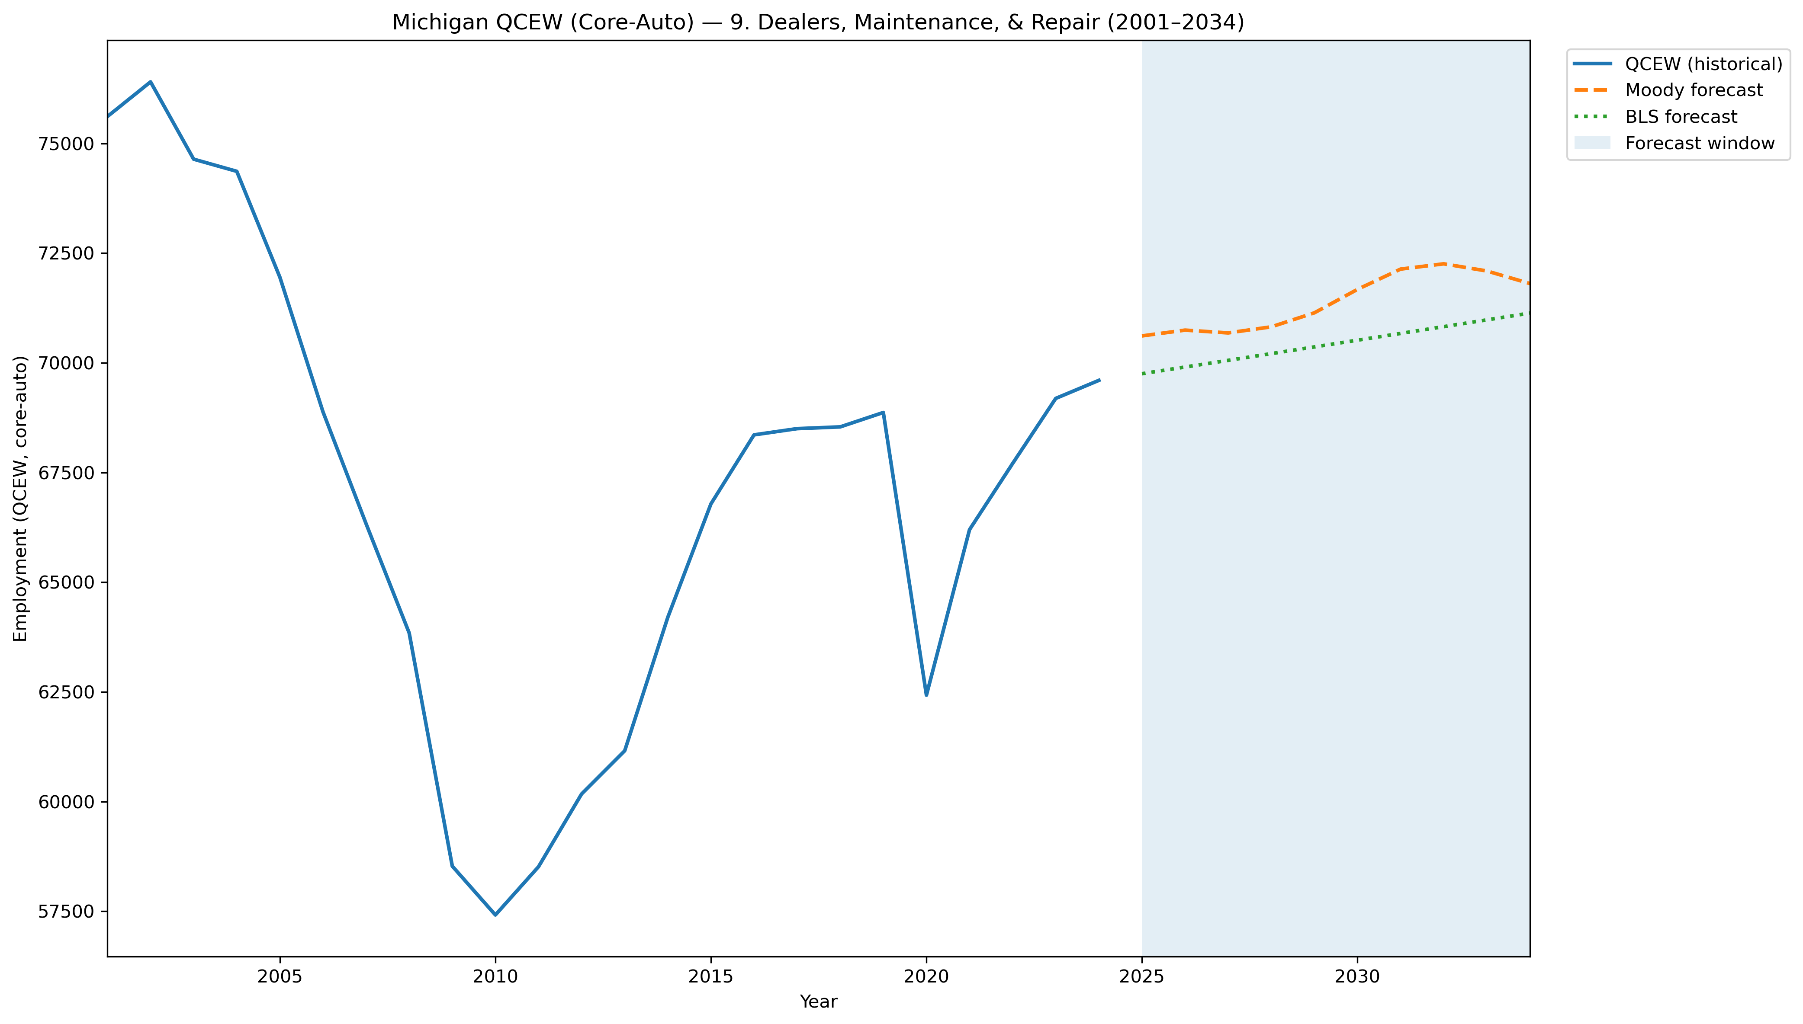
Mi Qcew Coreauto Segment 9 Compare 2001 2034
Source: EV Transition Forecasts

Slide 42
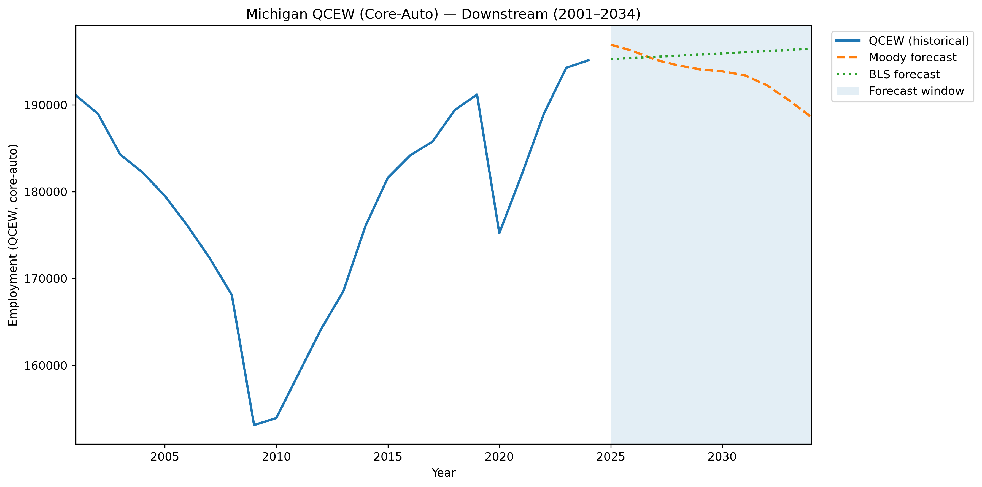
Mi Qcew Coreauto Stage Downstream Compare 2001 2034
Source: EV Transition Forecasts

Slide 43
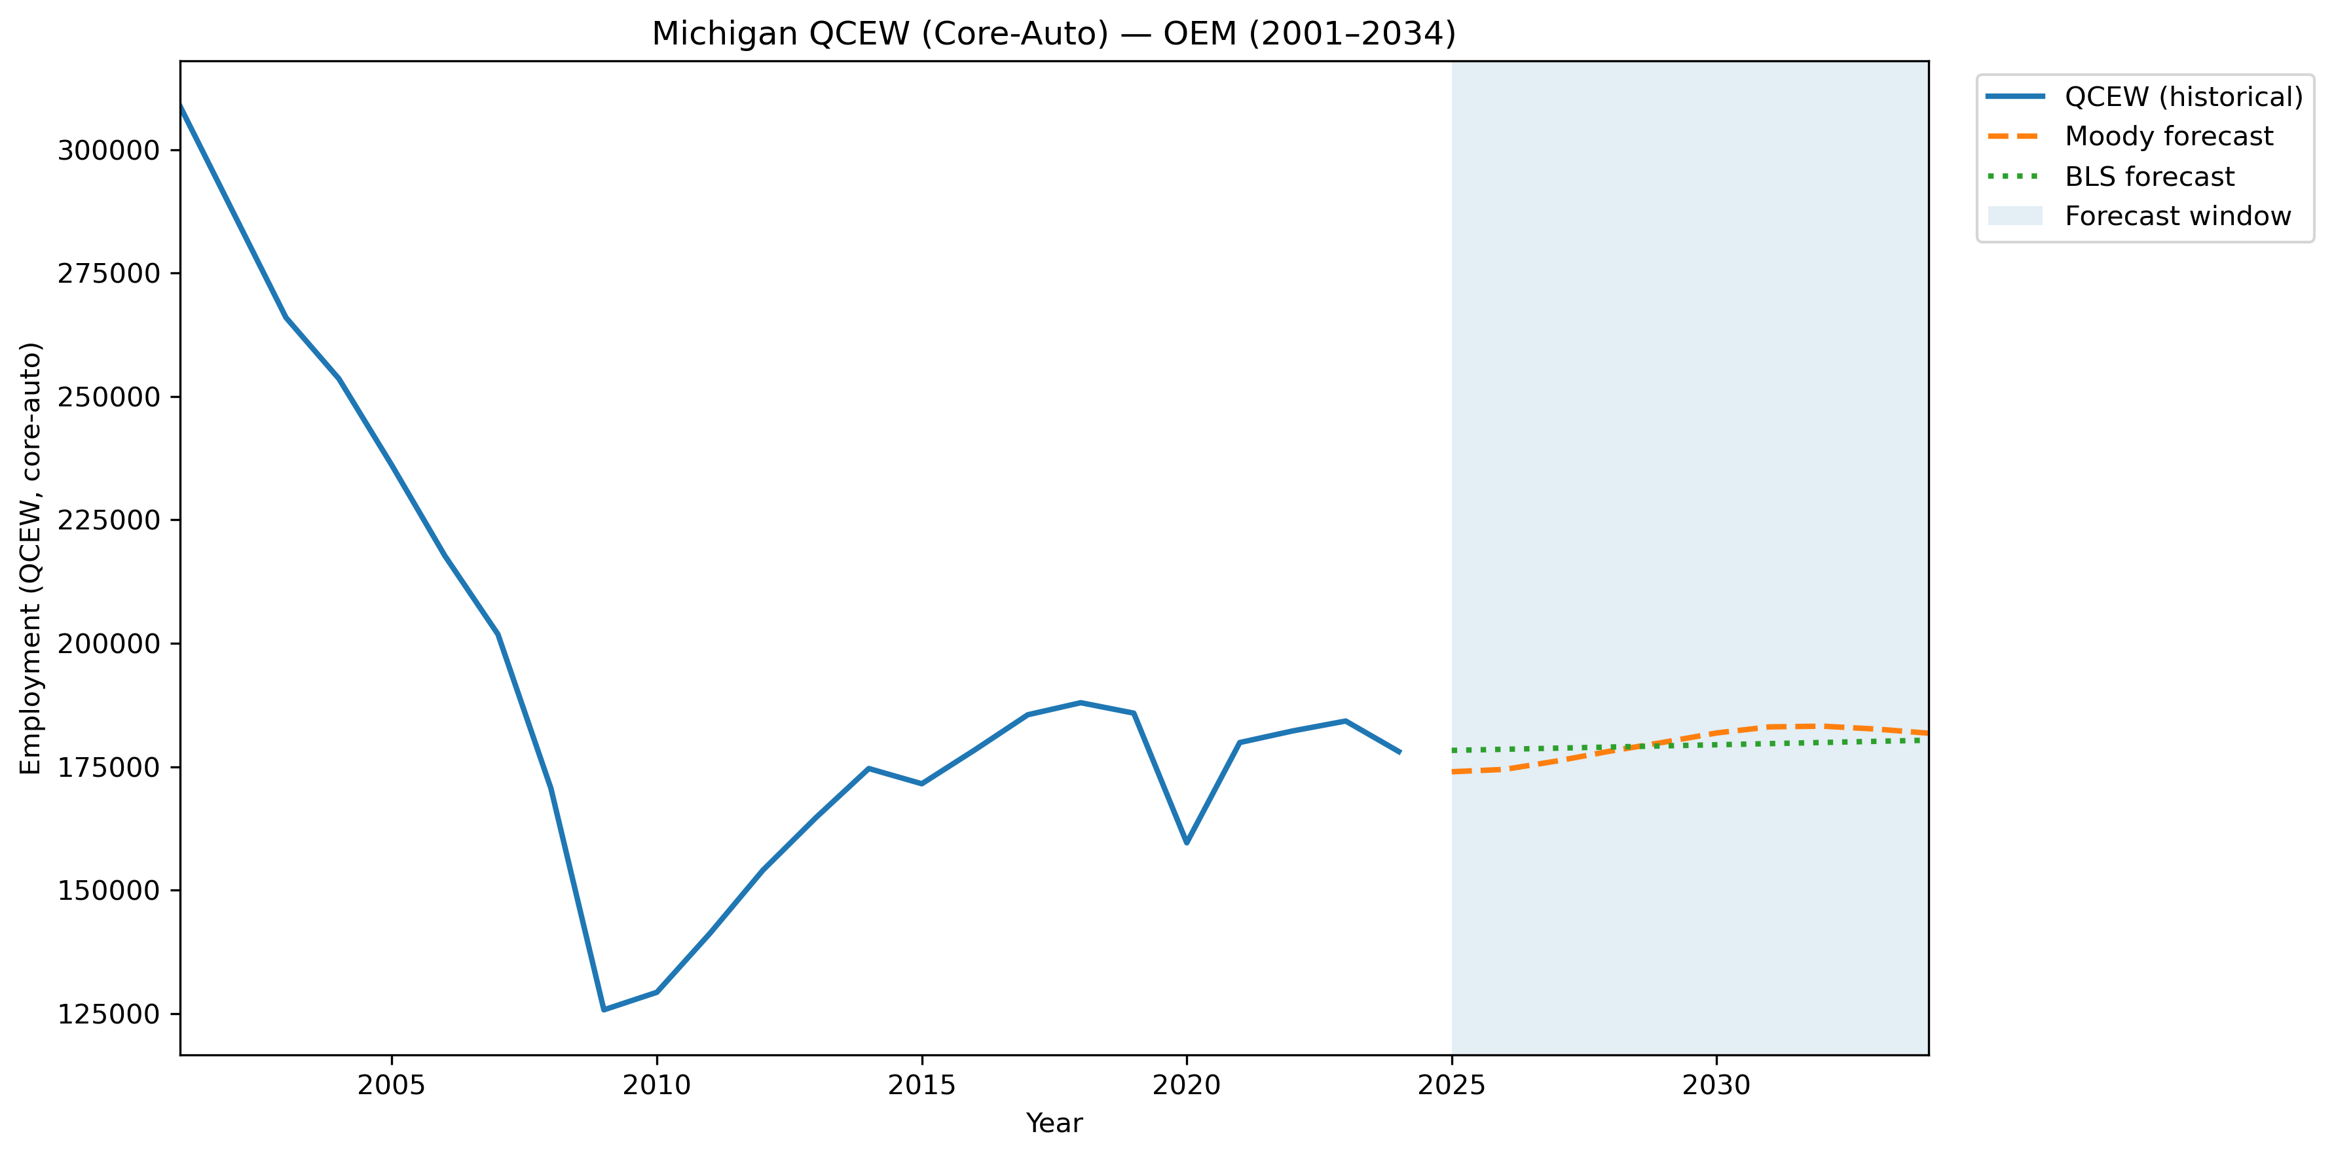
Mi Qcew Coreauto Stage Oem Compare 2001 2034
Source: EV Transition Forecasts

Slide 44
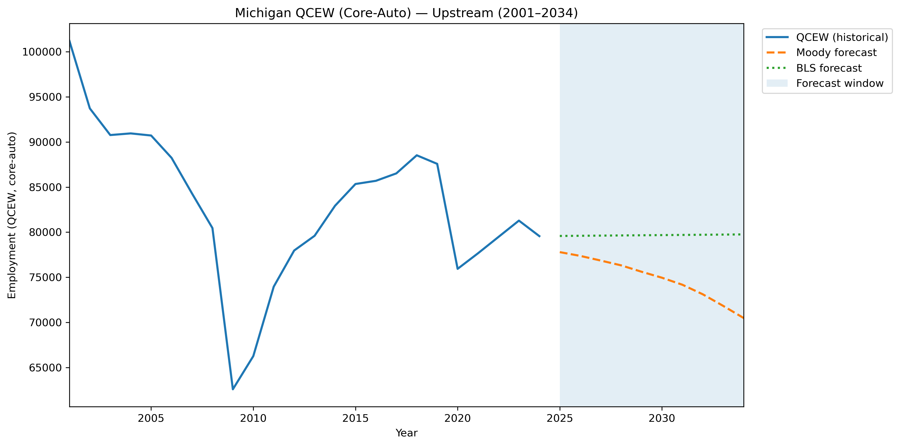
Mi Qcew Coreauto Stage Upstream Compare 2001 2034
Source: EV Transition Forecasts

Slide 45
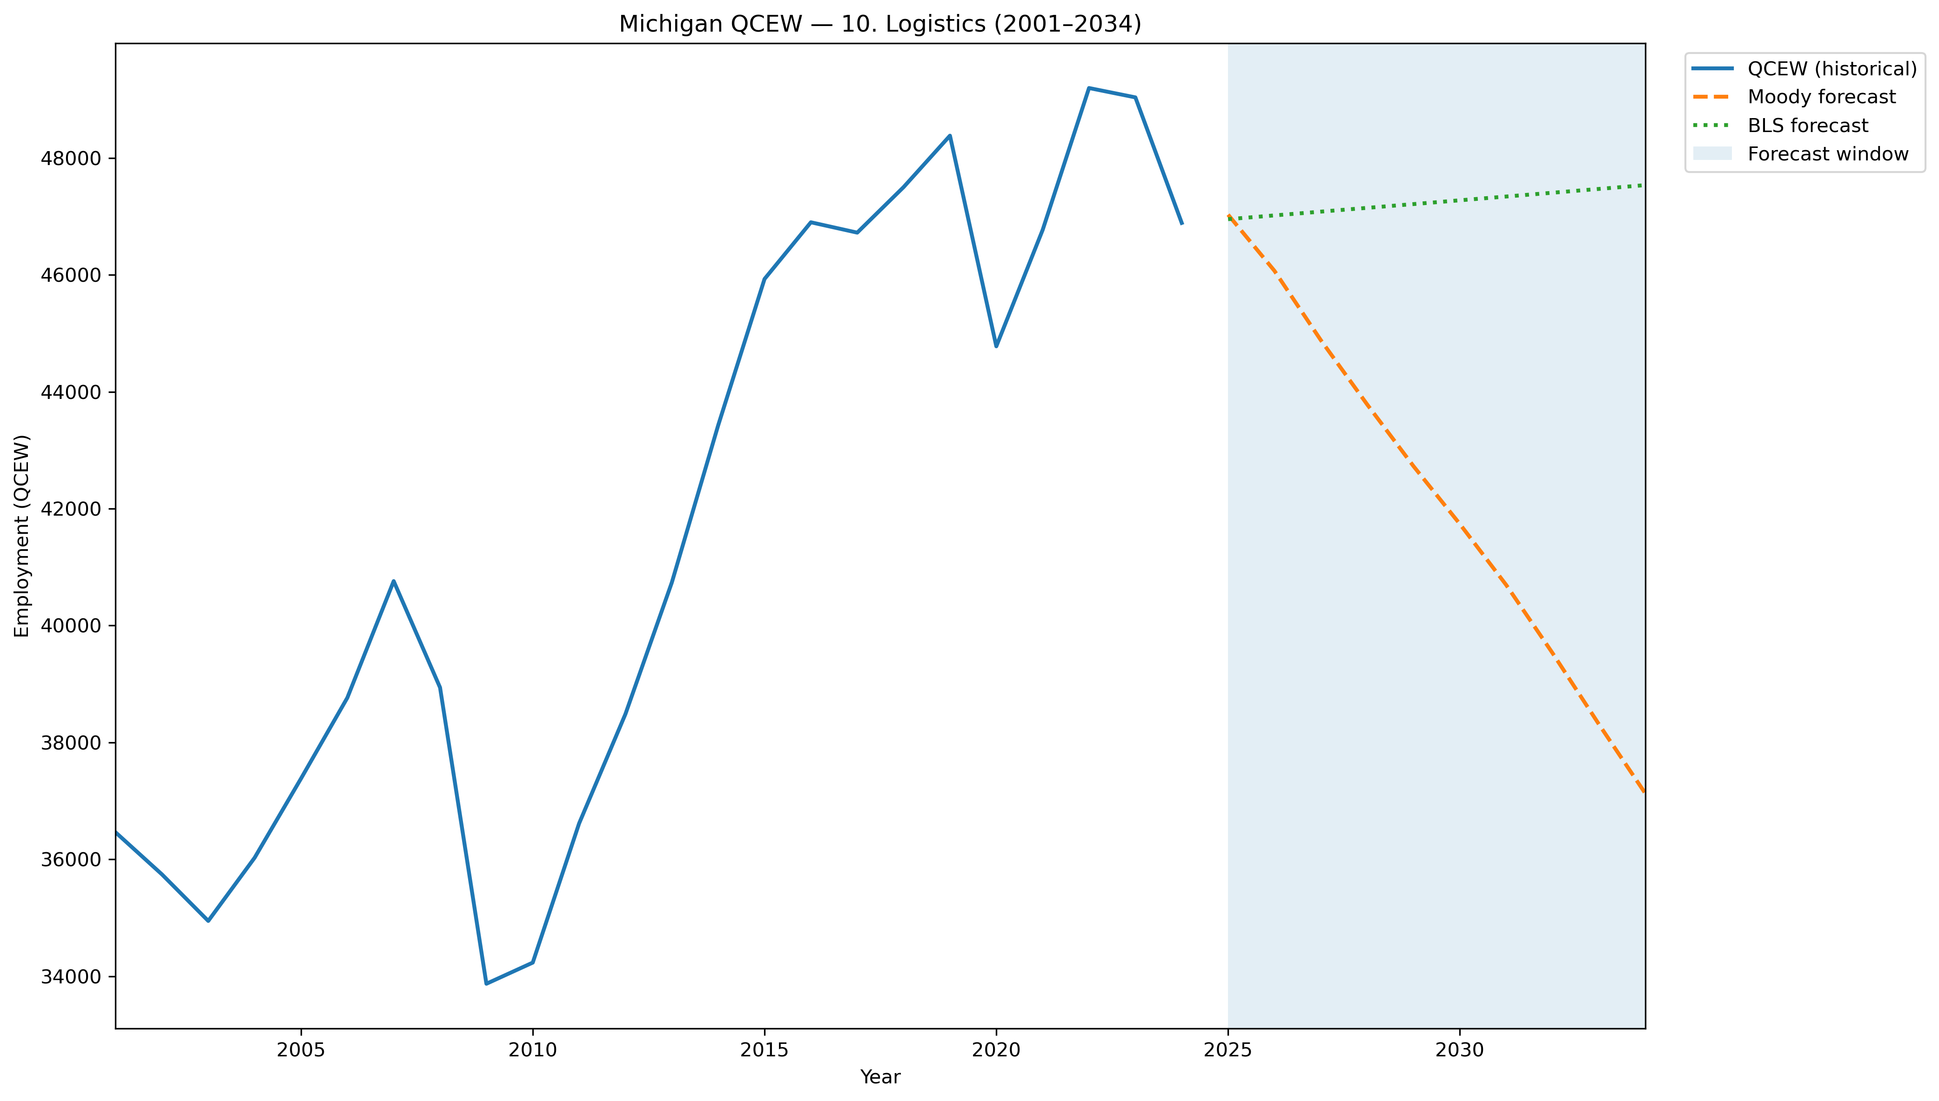
Mi Qcew Segment 10 Compare 2001 2034
Source: EV Transition Forecasts

Slide 46
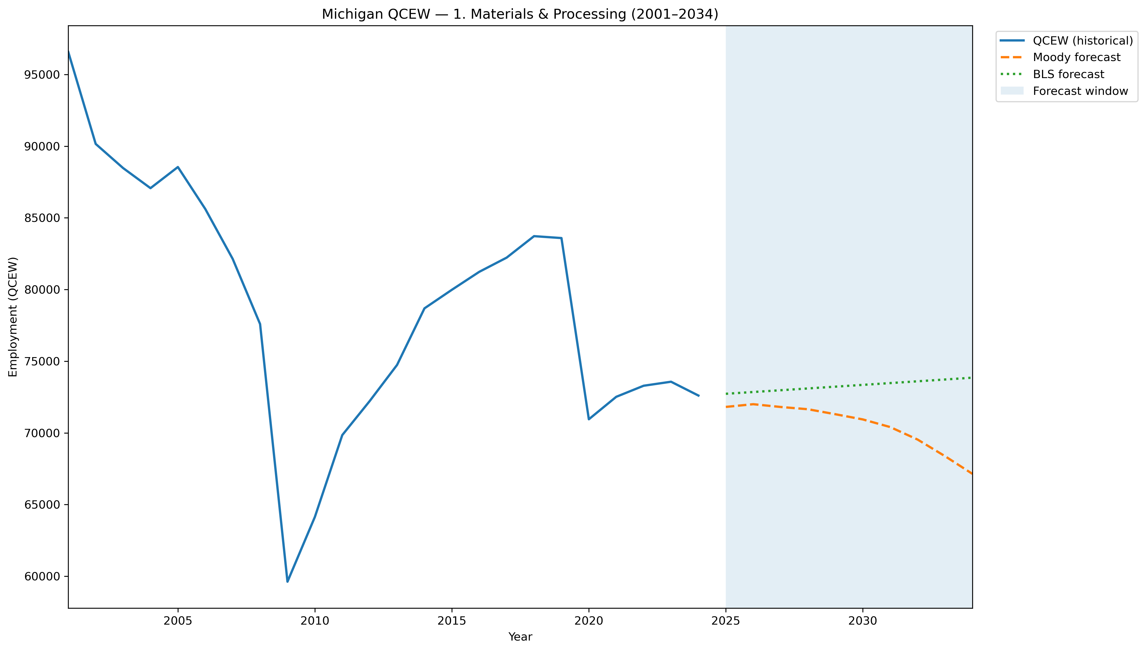
Mi Qcew Segment 1 Compare 2001 2034
Source: EV Transition Forecasts

Slide 47
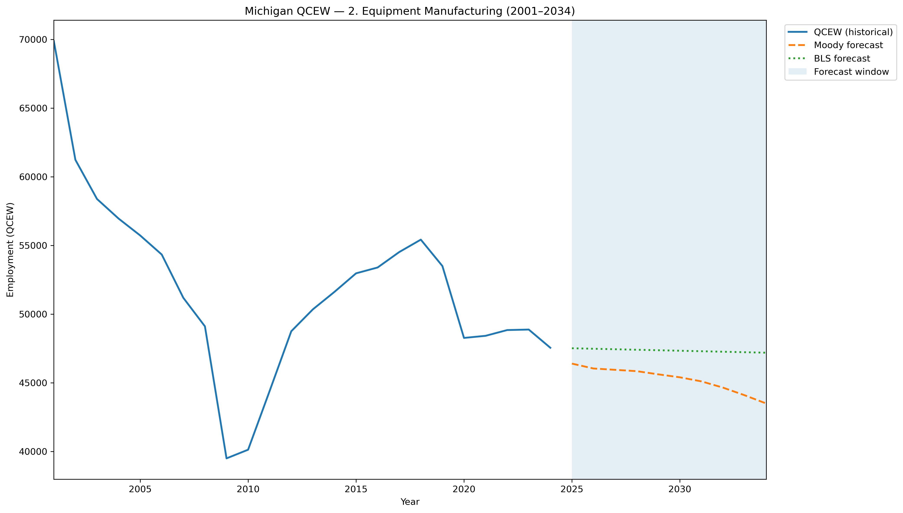
Mi Qcew Segment 2 Compare 2001 2034
Source: EV Transition Forecasts

Slide 48
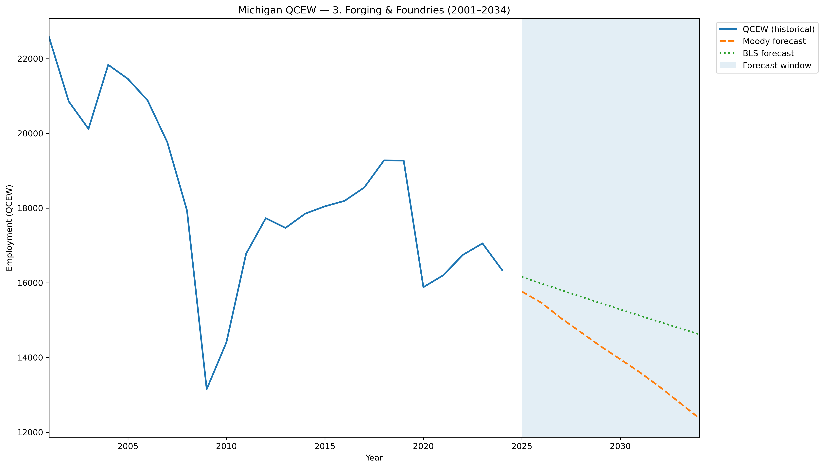
Mi Qcew Segment 3 Compare 2001 2034
Source: EV Transition Forecasts

Slide 49
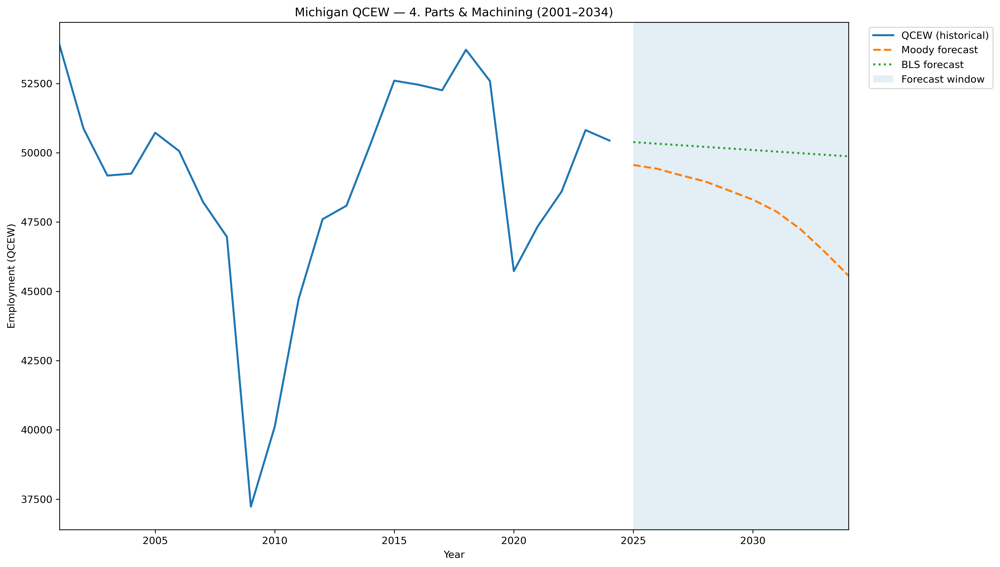
Mi Qcew Segment 4 Compare 2001 2034
Source: EV Transition Forecasts

Slide 50
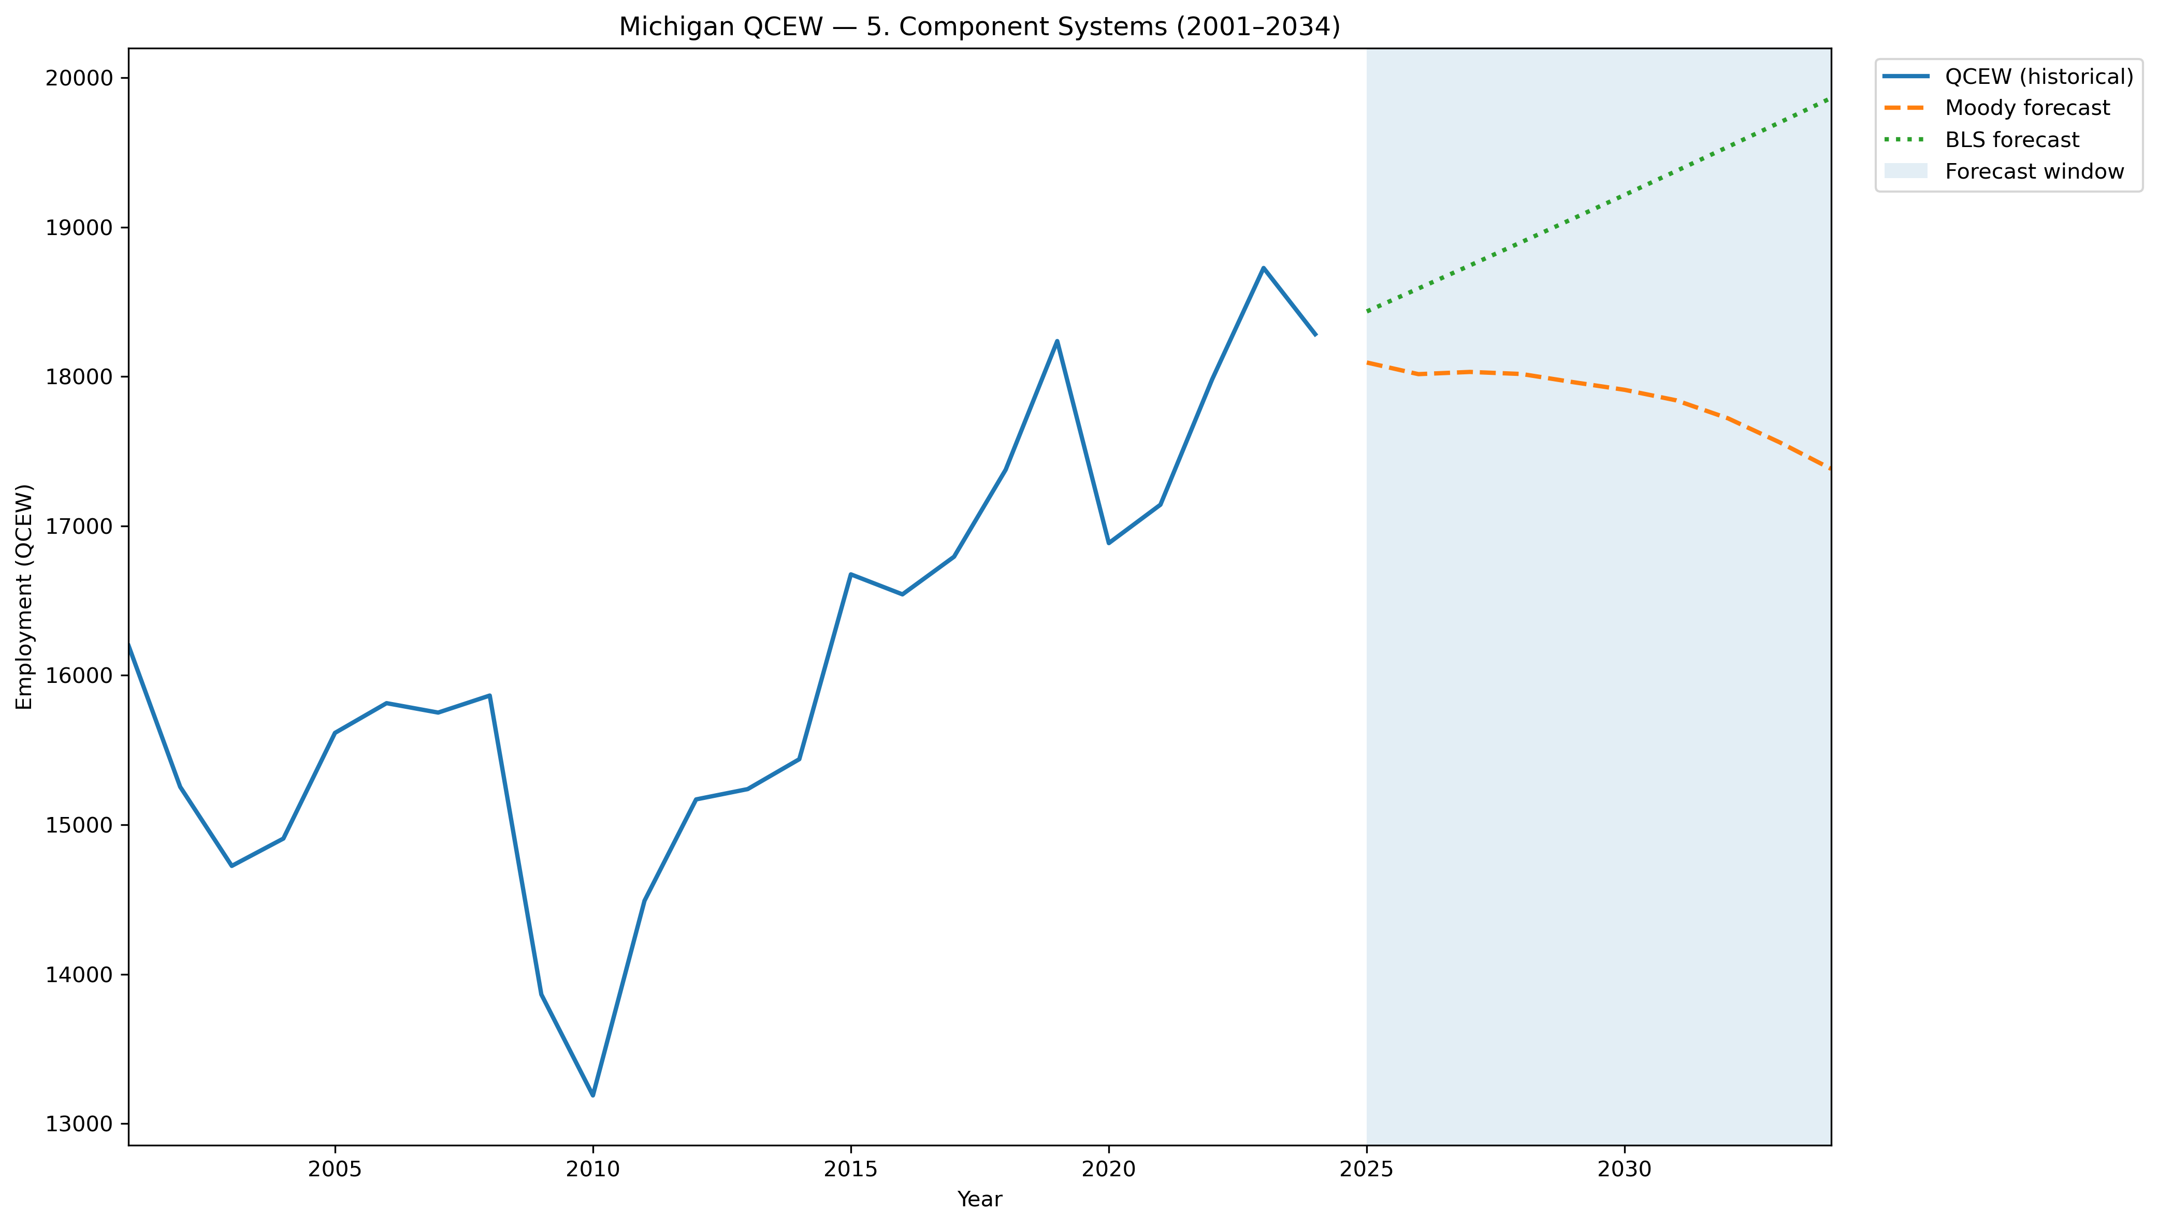
Mi Qcew Segment 5 Compare 2001 2034
Source: EV Transition Forecasts

Slide 51
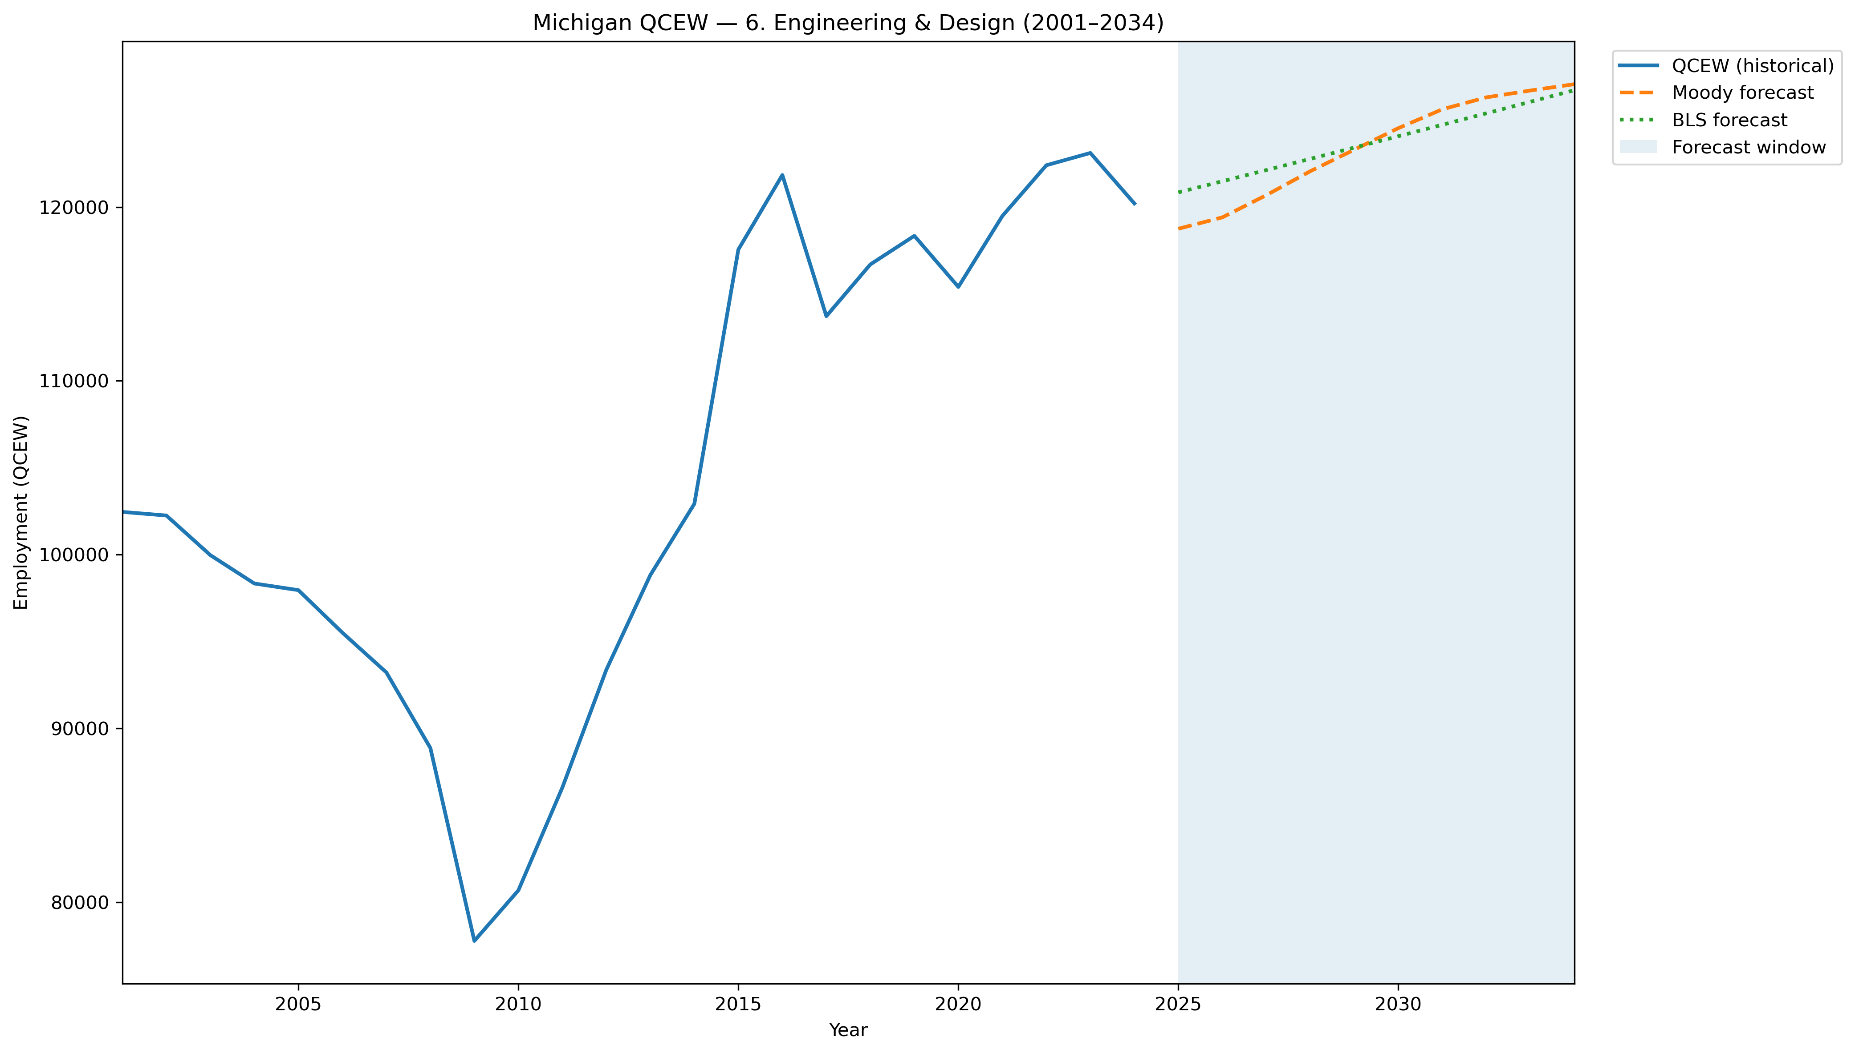
Mi Qcew Segment 6 Compare 2001 2034
Source: EV Transition Forecasts

Slide 52

Mi Qcew Segment 7 Compare 2001 2034
Source: EV Transition Forecasts

Slide 53

Mi Qcew Segment 8 Compare 2001 2034
Source: EV Transition Forecasts

Slide 54

Mi Qcew Segment 9 Compare 2001 2034
Source: EV Transition Forecasts

Slide 55

Mi Qcew Segment Employment Trends
Source: EV Transition Forecasts

Slide 56

Mi Qcew Segments 2001 2034 With Forecast
Source: EV Transition Forecasts

Slide 57

Mi Qcew Stage Downstream Compare 2001 2034
Source: EV Transition Forecasts

Slide 58

Mi Qcew Stage Employment Trends
Source: EV Transition Forecasts

Slide 59

Mi Qcew Stage Oem Compare 2001 2034
Source: EV Transition Forecasts

Slide 60

Mi Qcew Stage Upstream Compare 2001 2034
Source: EV Transition Forecasts

Slide 61

Mi Qcew Stages 2001 2034 With Forecast
Source: EV Transition Forecasts

Slide 62

Moodys Mi Segment Employment 1970 2055
Source: EV Transition Forecasts

Slide 63

Moodys Mi Segment Employment 1990 2030
Source: EV Transition Forecasts

Slide 64

Moodys Mi Segment Gdp 1970 2055
Source: EV Transition Forecasts

Slide 65

Moodys Mi Segment Gdp 1990 2030
Source: EV Transition Forecasts

Slide 66

Moodys Mi Stage Employment 1970 2055
Source: EV Transition Forecasts

Slide 67

Moodys Mi Stage Employment 1990 2030
Source: EV Transition Forecasts

Slide 68

Moodys Mi Stage Gdp 1970 2055
Source: EV Transition Forecasts

Slide 69

Moodys Mi Stage Gdp 1990 2030
Source: EV Transition Forecasts

Slide 70

Moodys Us Segment Employment 1970 2055
Source: EV Transition Forecasts

Slide 71

Moodys Us Segment Employment 1990 2030
Source: EV Transition Forecasts

Slide 72

Moodys Us Segment Gdp 1970 2055
Source: EV Transition Forecasts

Slide 73

Moodys Us Segment Gdp 1990 2030
Source: EV Transition Forecasts

Slide 74

Moodys Us Stage Employment 1970 2055
Source: EV Transition Forecasts

Slide 75

Moodys Us Stage Employment 1990 2030
Source: EV Transition Forecasts

Slide 76

Moodys Us Stage Gdp 1970 2055
Source: EV Transition Forecasts

Slide 77

Moodys Us Stage Gdp 1990 2030
Source: EV Transition Forecasts

Slide 78

Occupation Methodology Comparison 2030
Source: EV Transition Forecasts

Slide 79
Occupation Segment Employment 2030
Source: EV Transition Forecasts

Slide 80

Occupation Top15 2030
Source: EV Transition Forecasts

Slide 81

Occupation Top5 Timeseries 2024 2034
Source: EV Transition Forecasts

Slide 82

Segment Employment Pct Change 2024 2030
Source: EV Transition Forecasts

Slide 83

Segment Gdpgpo Pct Change 2024 2030
Source: EV Transition Forecasts

Slide 84

Segment Wages Pct Change 2024 2030
Source: EV Transition Forecasts

Slide 85

Stage Employment Pct Change 2024 2030
Source: EV Transition Forecasts

Slide 86

Stage Gdpgpo Pct Change 2024 2030
Source: EV Transition Forecasts

Slide 87

Stage Wages Pct Change 2024 2030
Source: EV Transition Forecasts

